Slide 1
To do (as of ¾)
Confirm color
Update last slide
Save all as image
Create gif

Slide 2
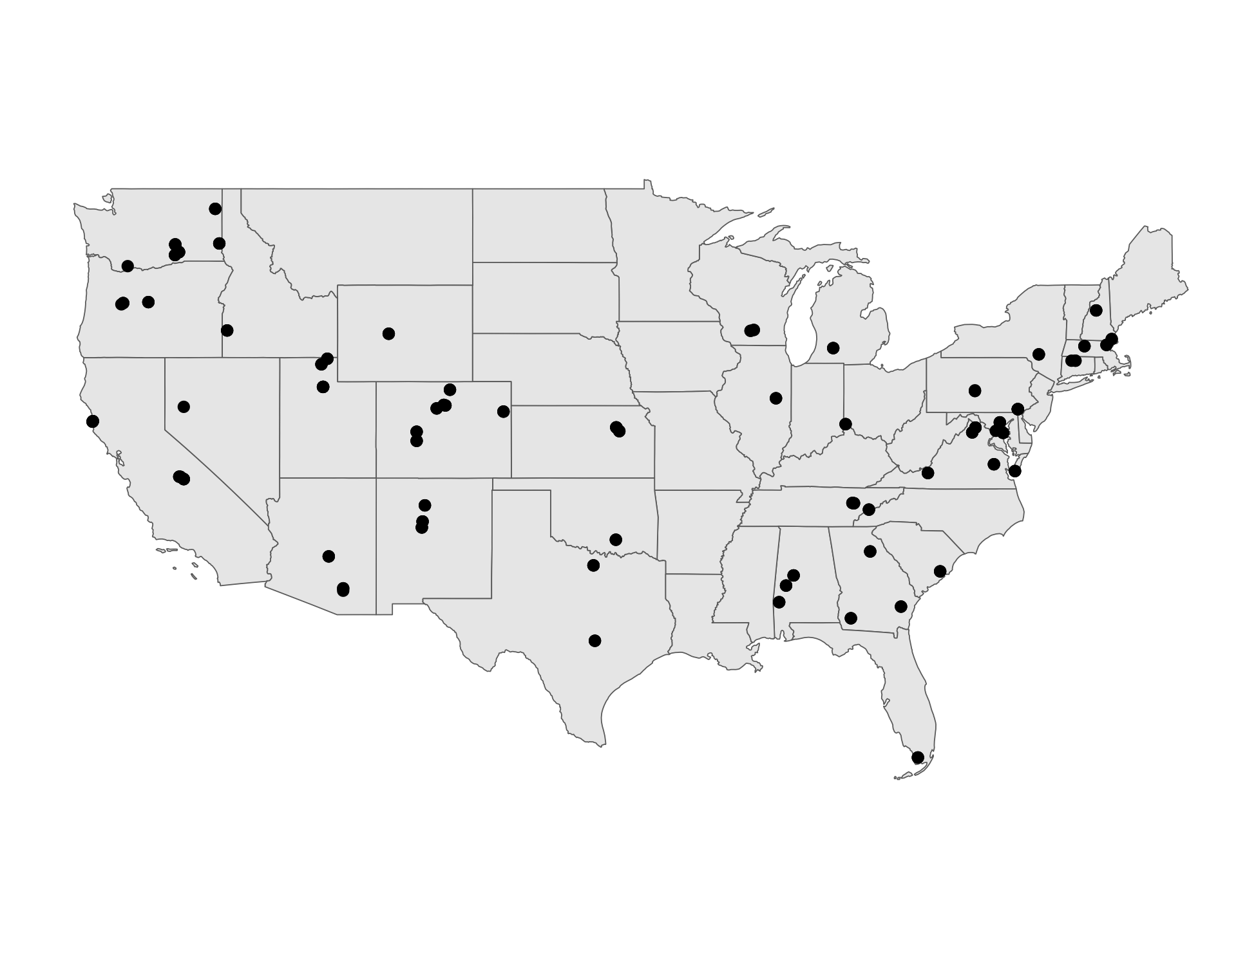
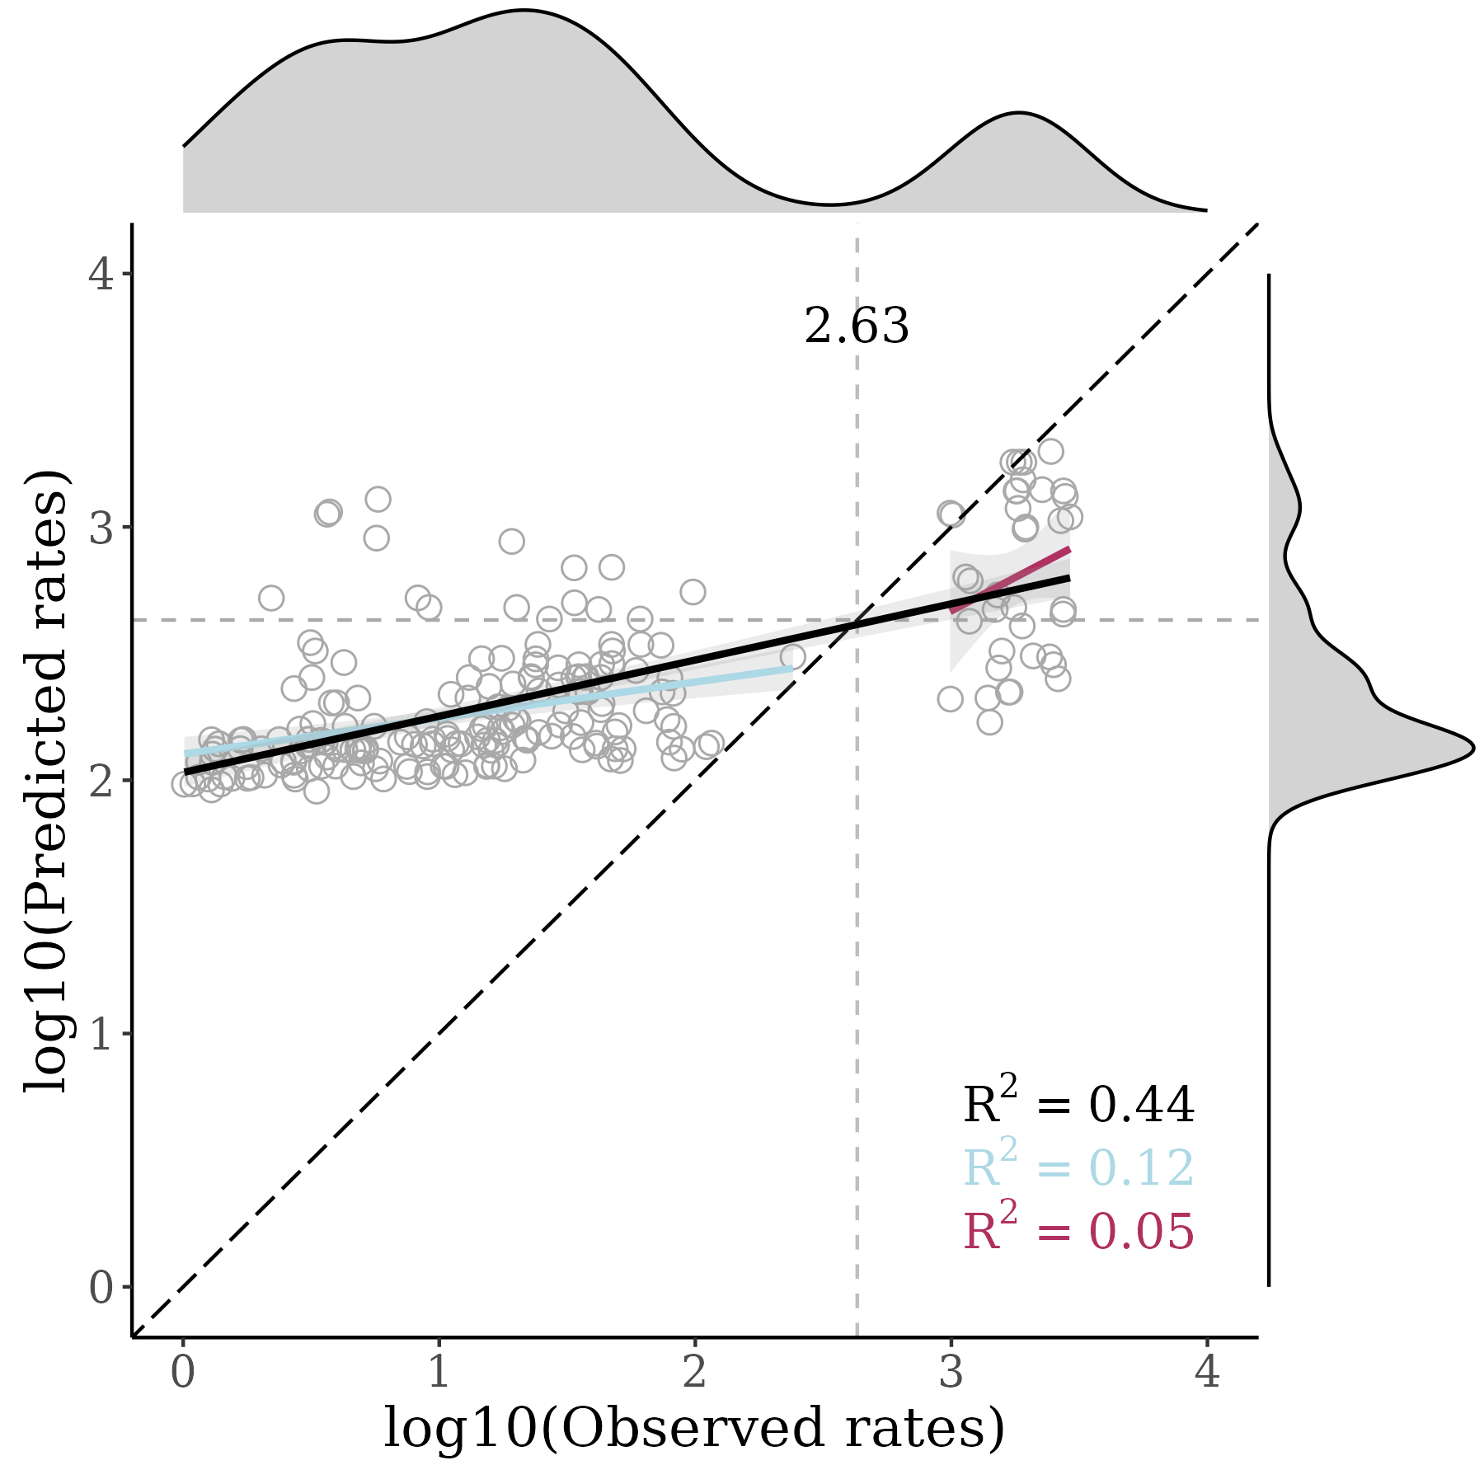
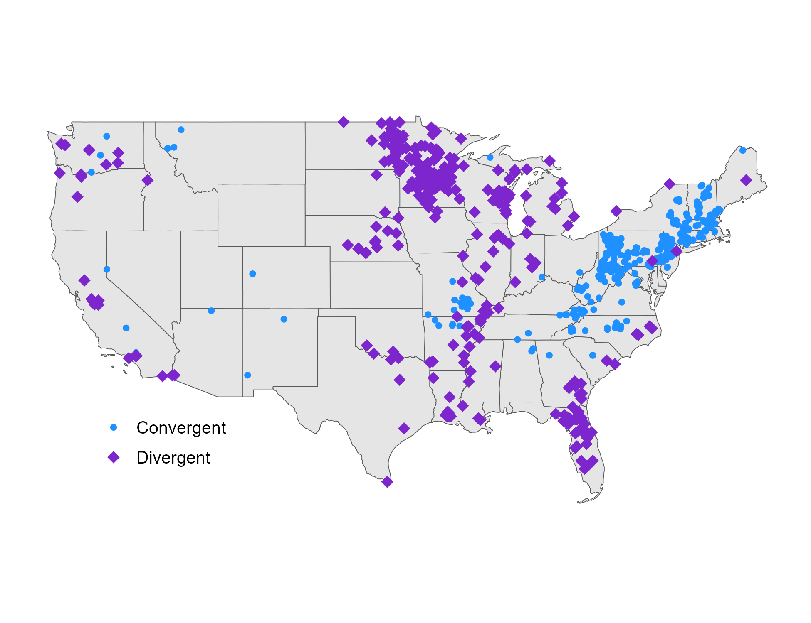
December 2021
SAMPLED SITES
MODEL PERFORMANCE
HIGH PRIORITY SITES

Slide 3

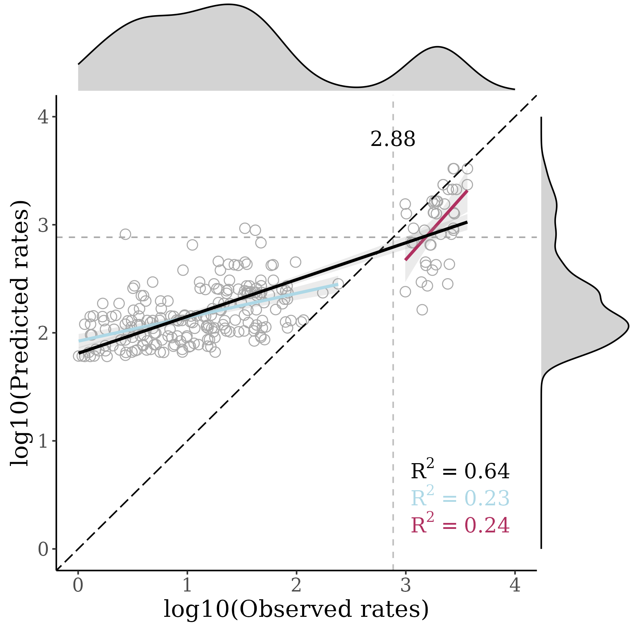
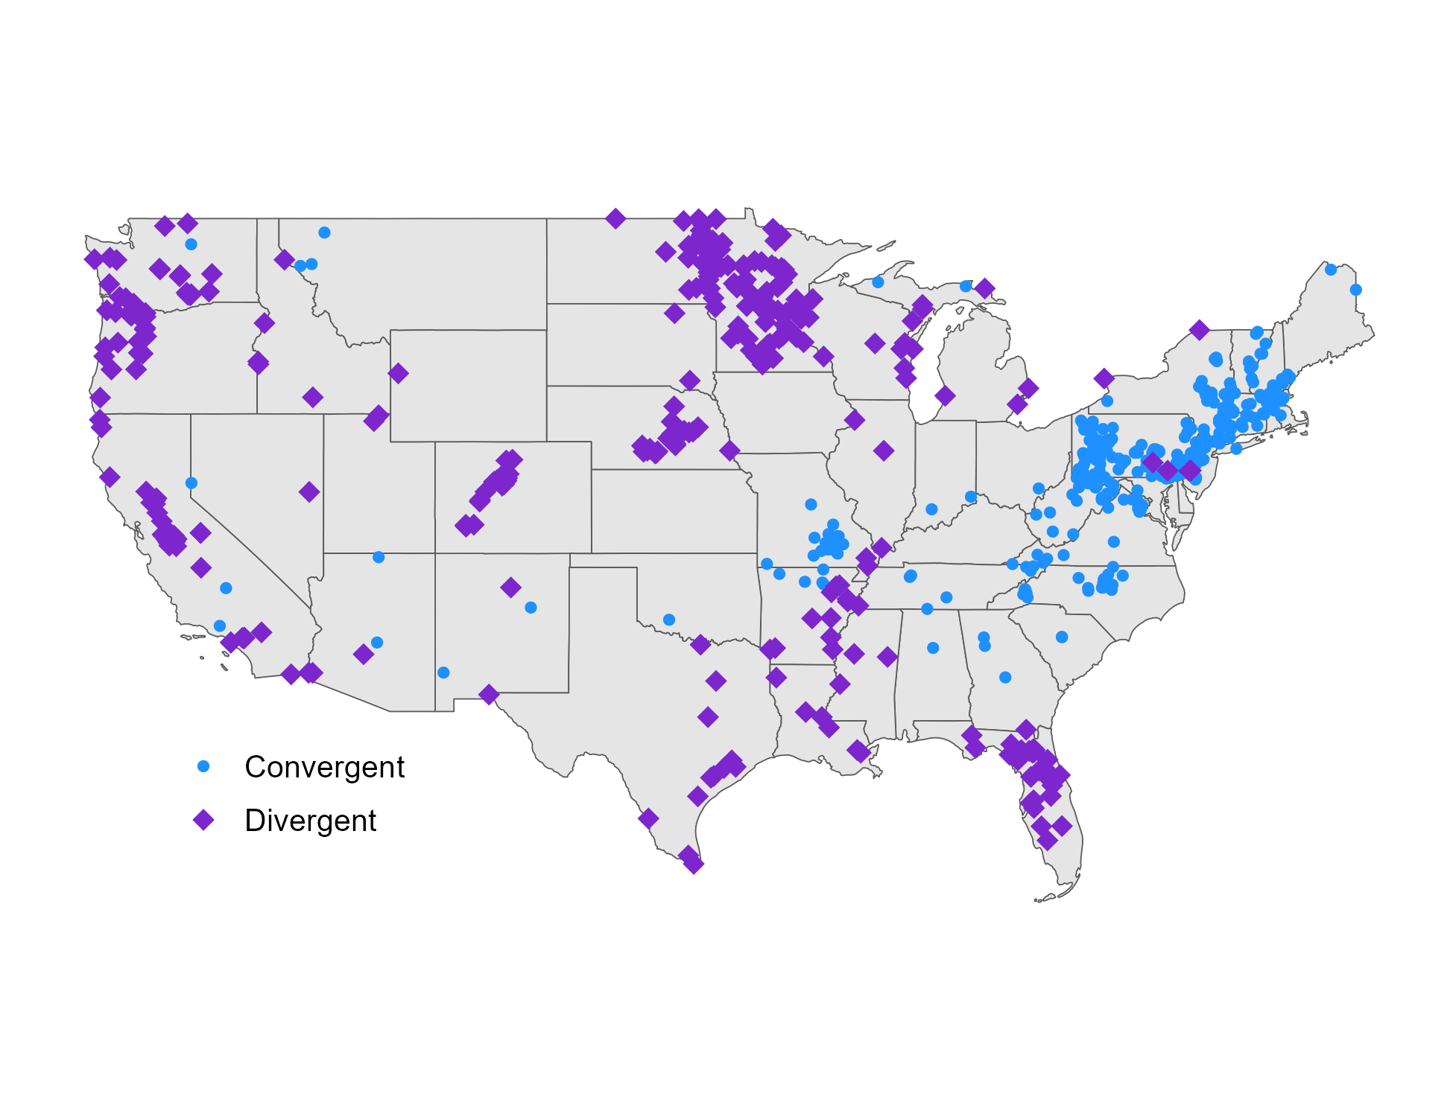
July 2022
SAMPLED SITES
MODEL PERFORMANCE
HIGH PRIORITY SITES

Slide 4

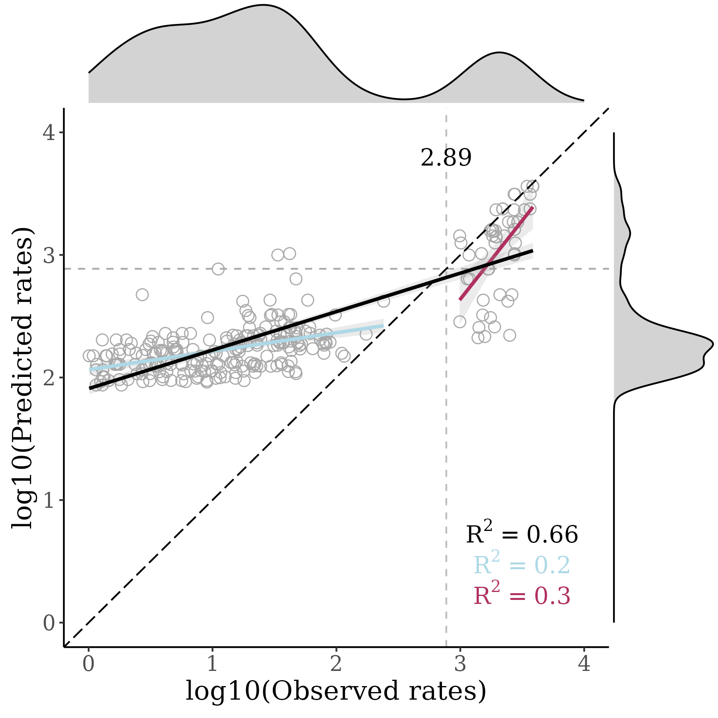

August 2022
SAMPLED SITES
MODEL PERFORMANCE
HIGH PRIORITY SITES

Slide 5

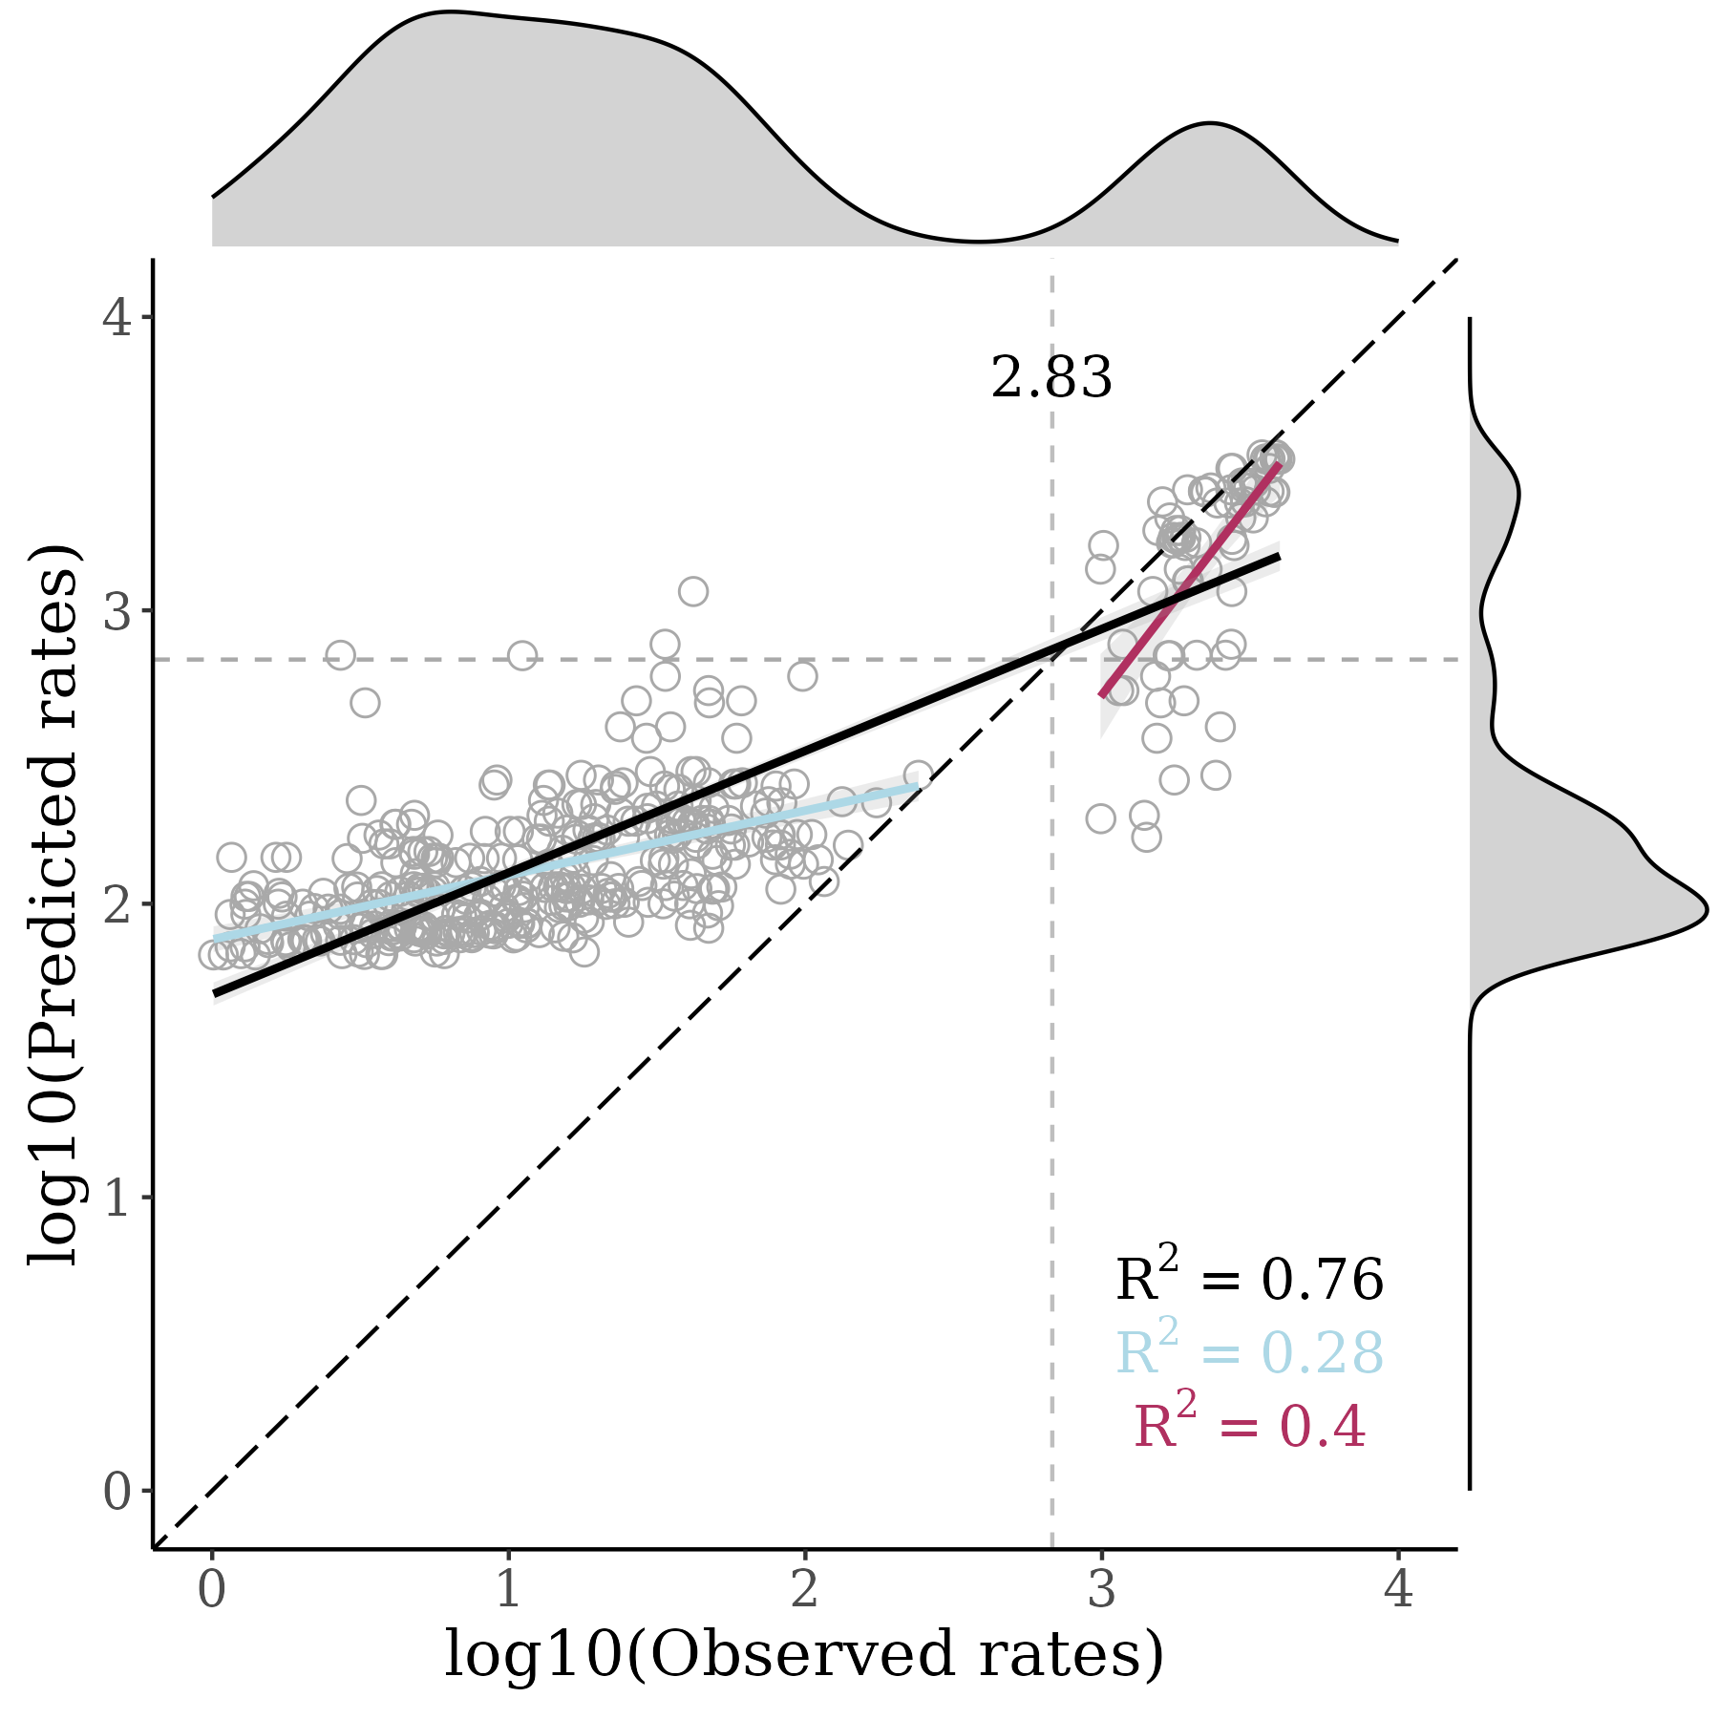
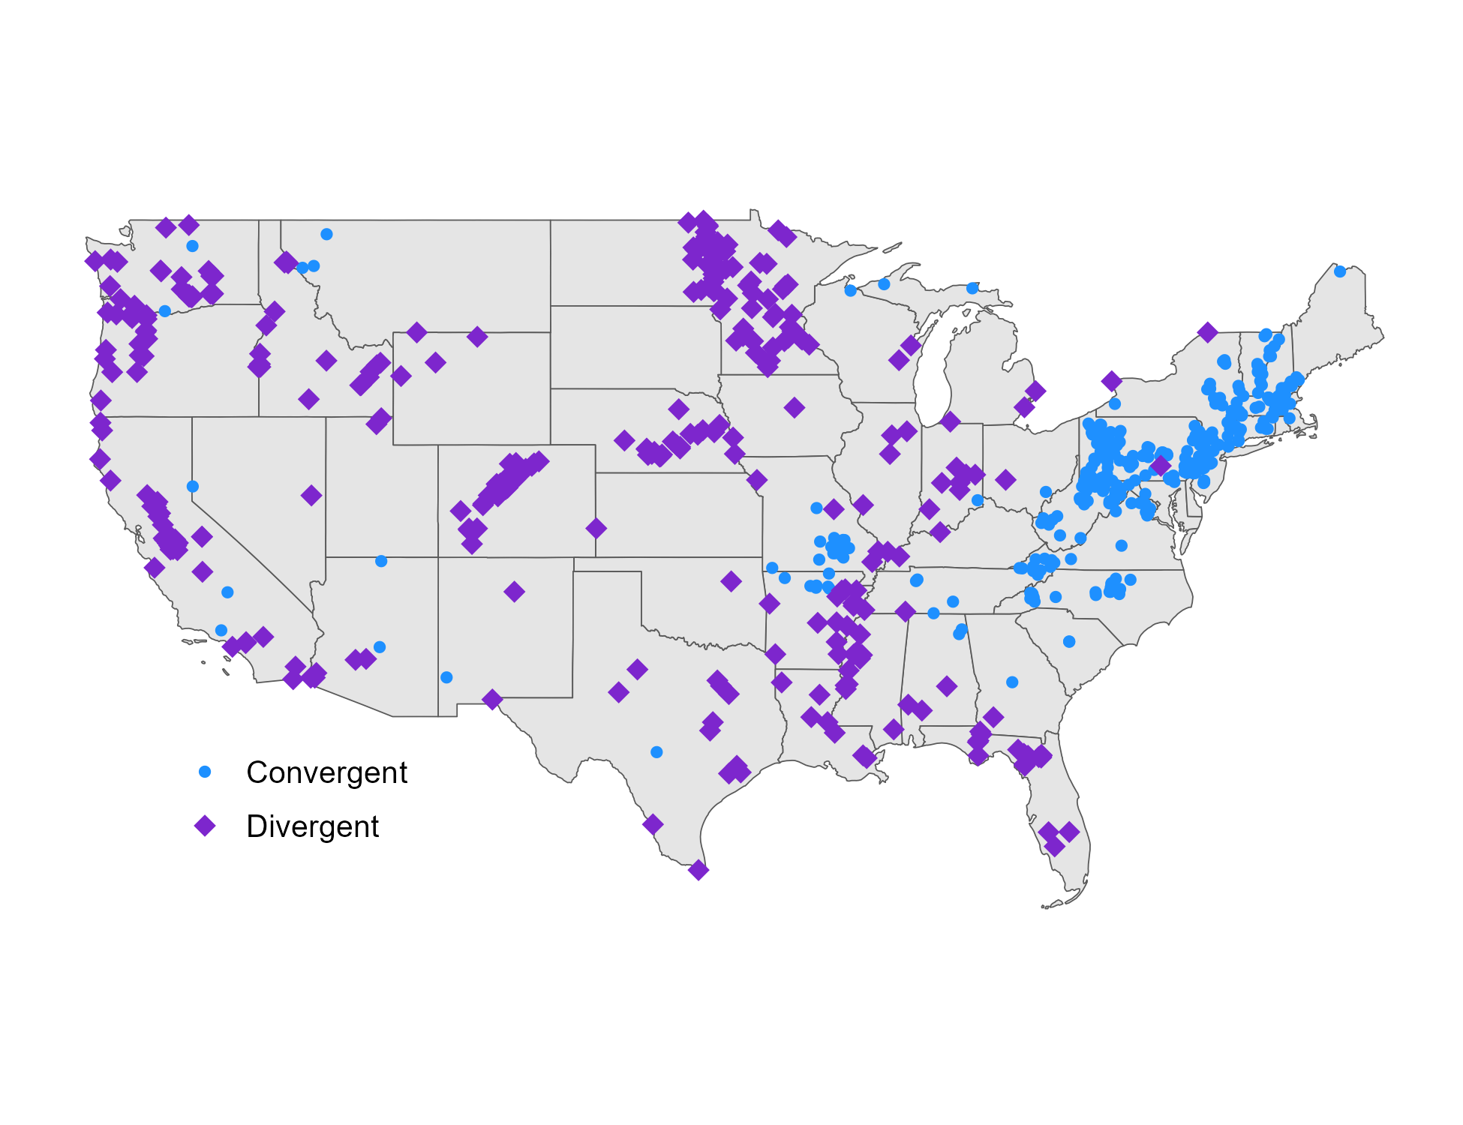
September 2022
SAMPLED SITES
MODEL PERFORMANCE
HIGH PRIORITY SITES

Slide 6

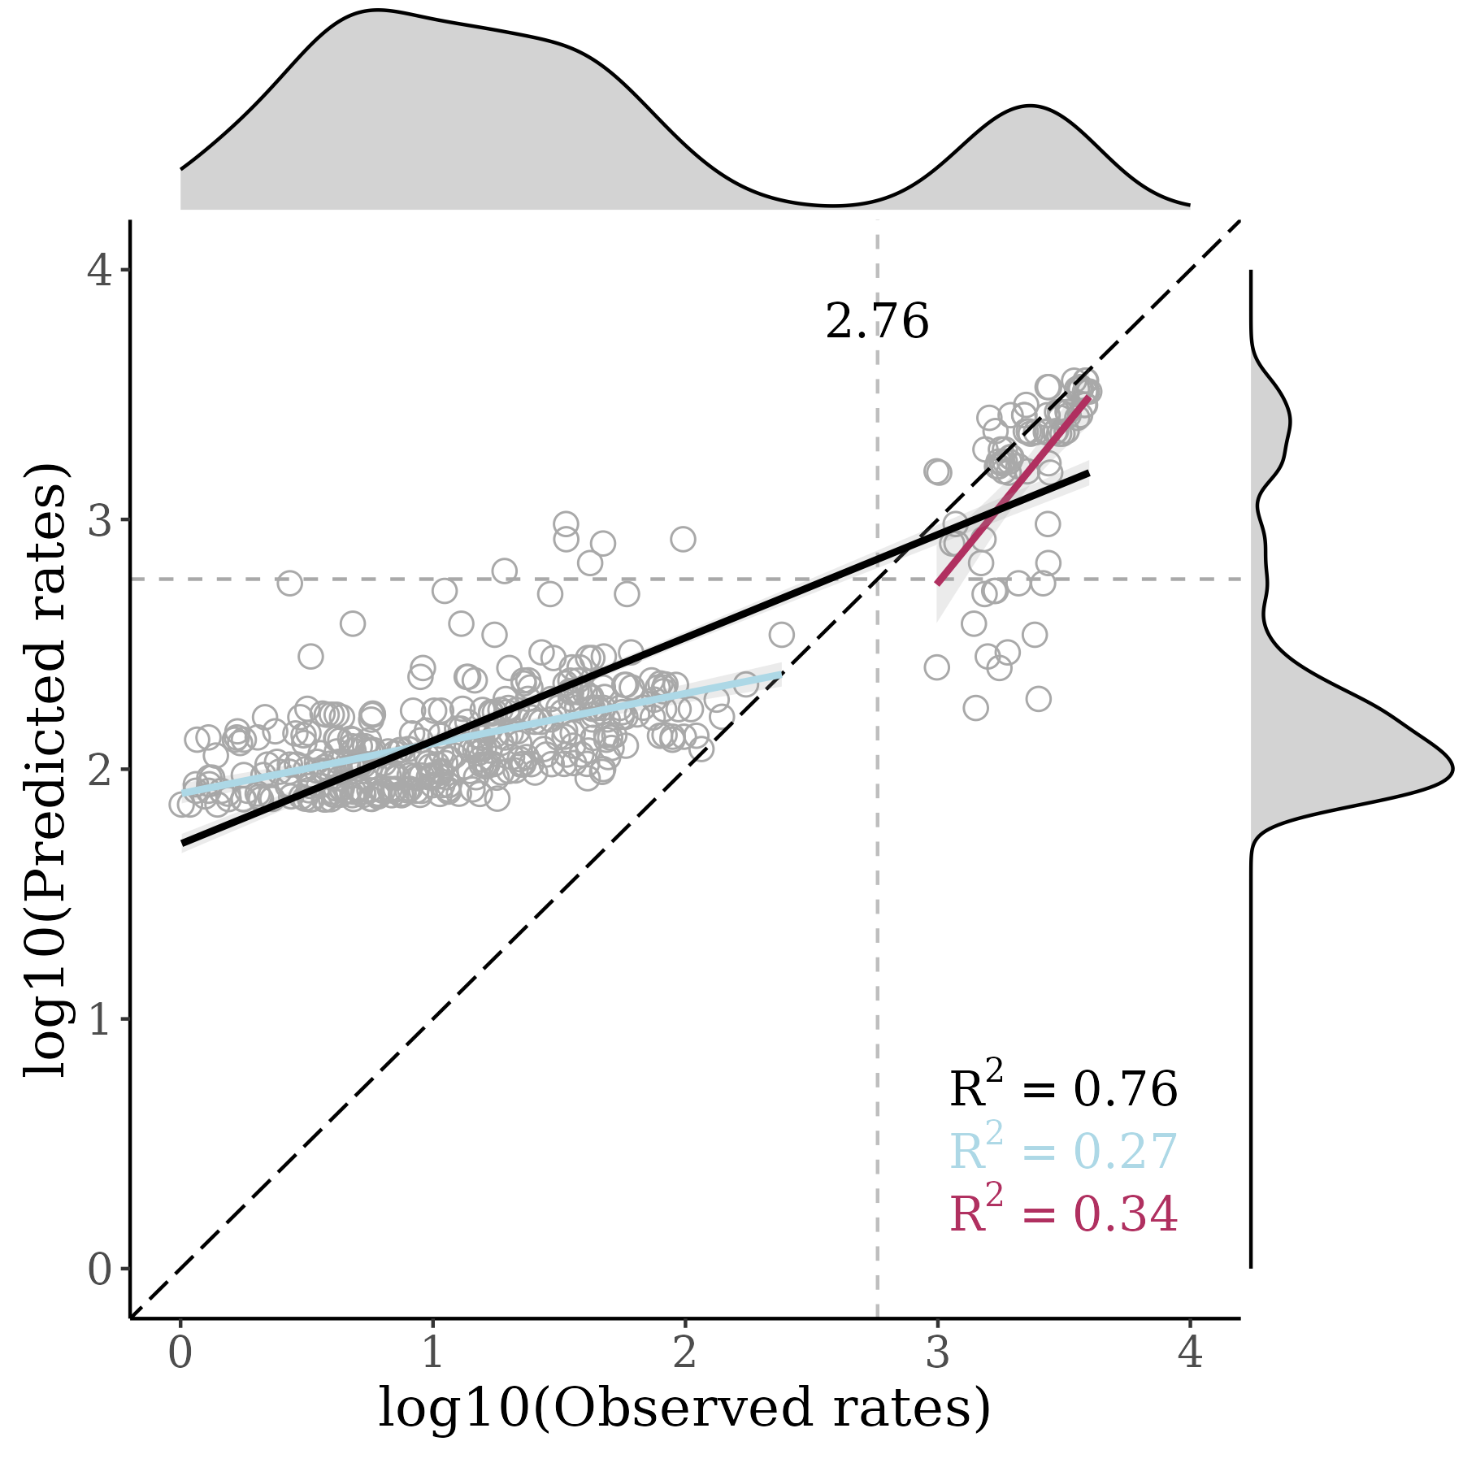
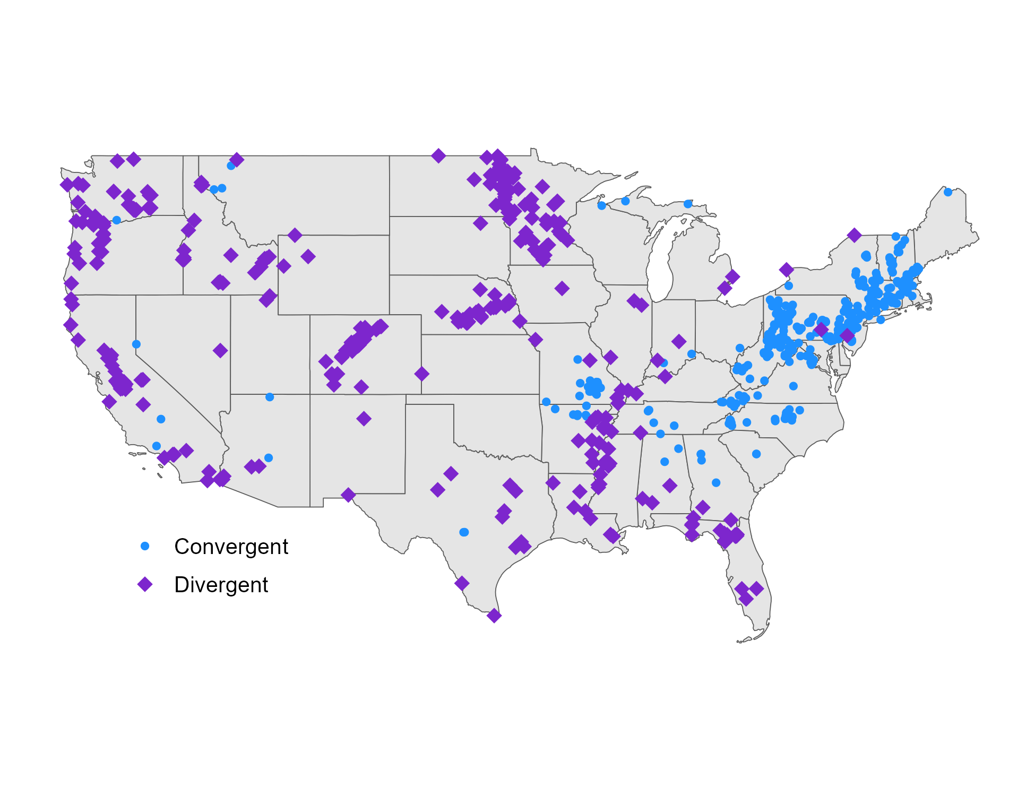
October 2022
SAMPLED SITES
MODEL PERFORMANCE
HIGH PRIORITY SITES

Slide 7

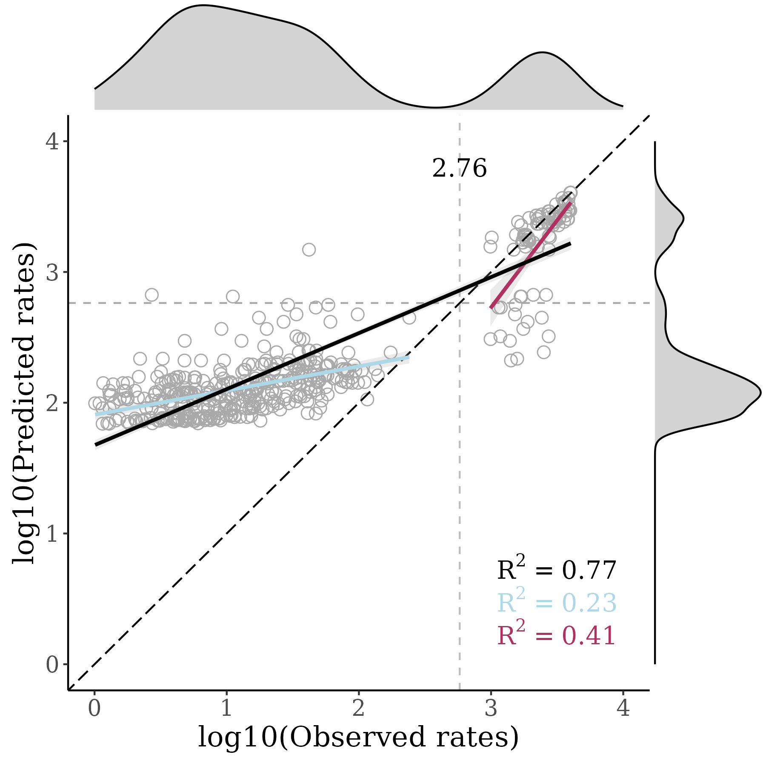
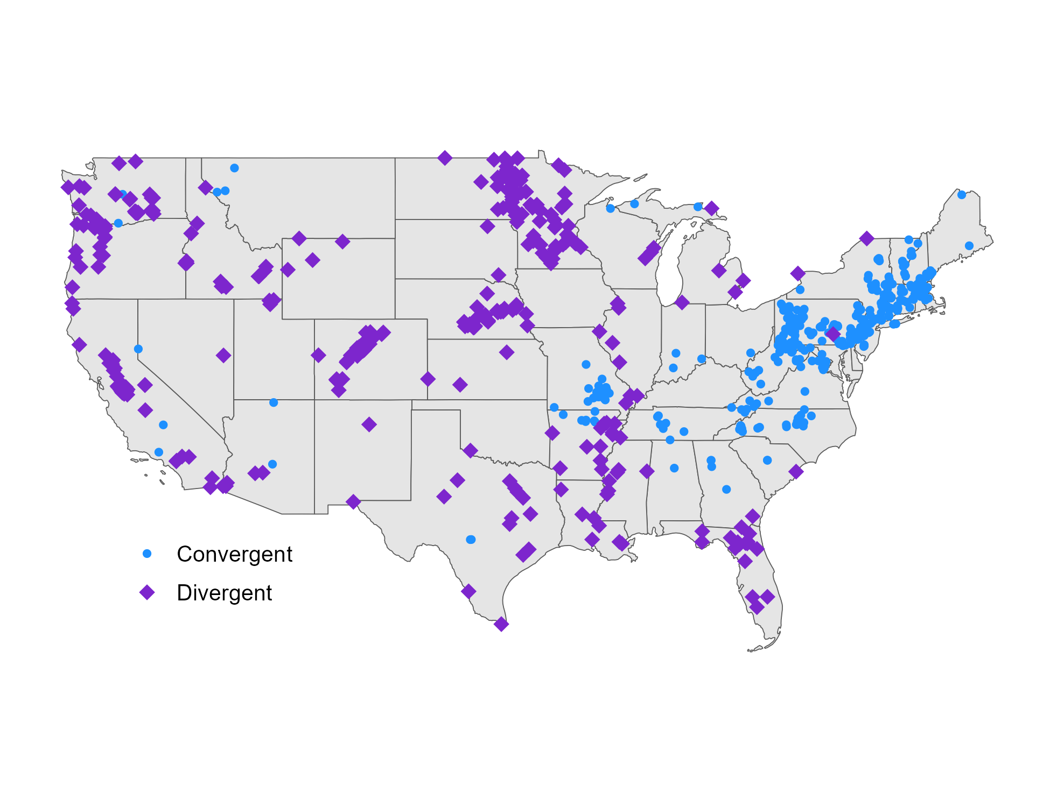
November 2022
SAMPLED SITES
MODEL PERFORMANCE
HIGH PRIORITY SITES

Slide 8

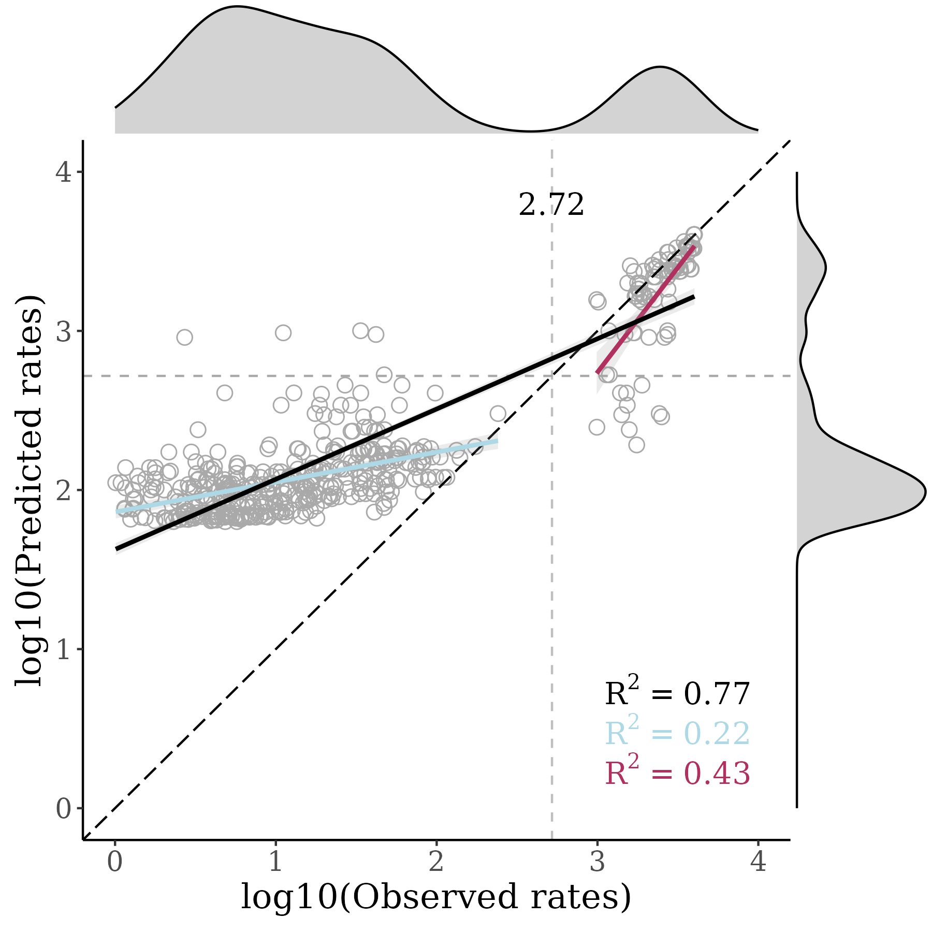

December 2022
SAMPLED SITES
MODEL PERFORMANCE
HIGH PRIORITY SITES

Slide 9

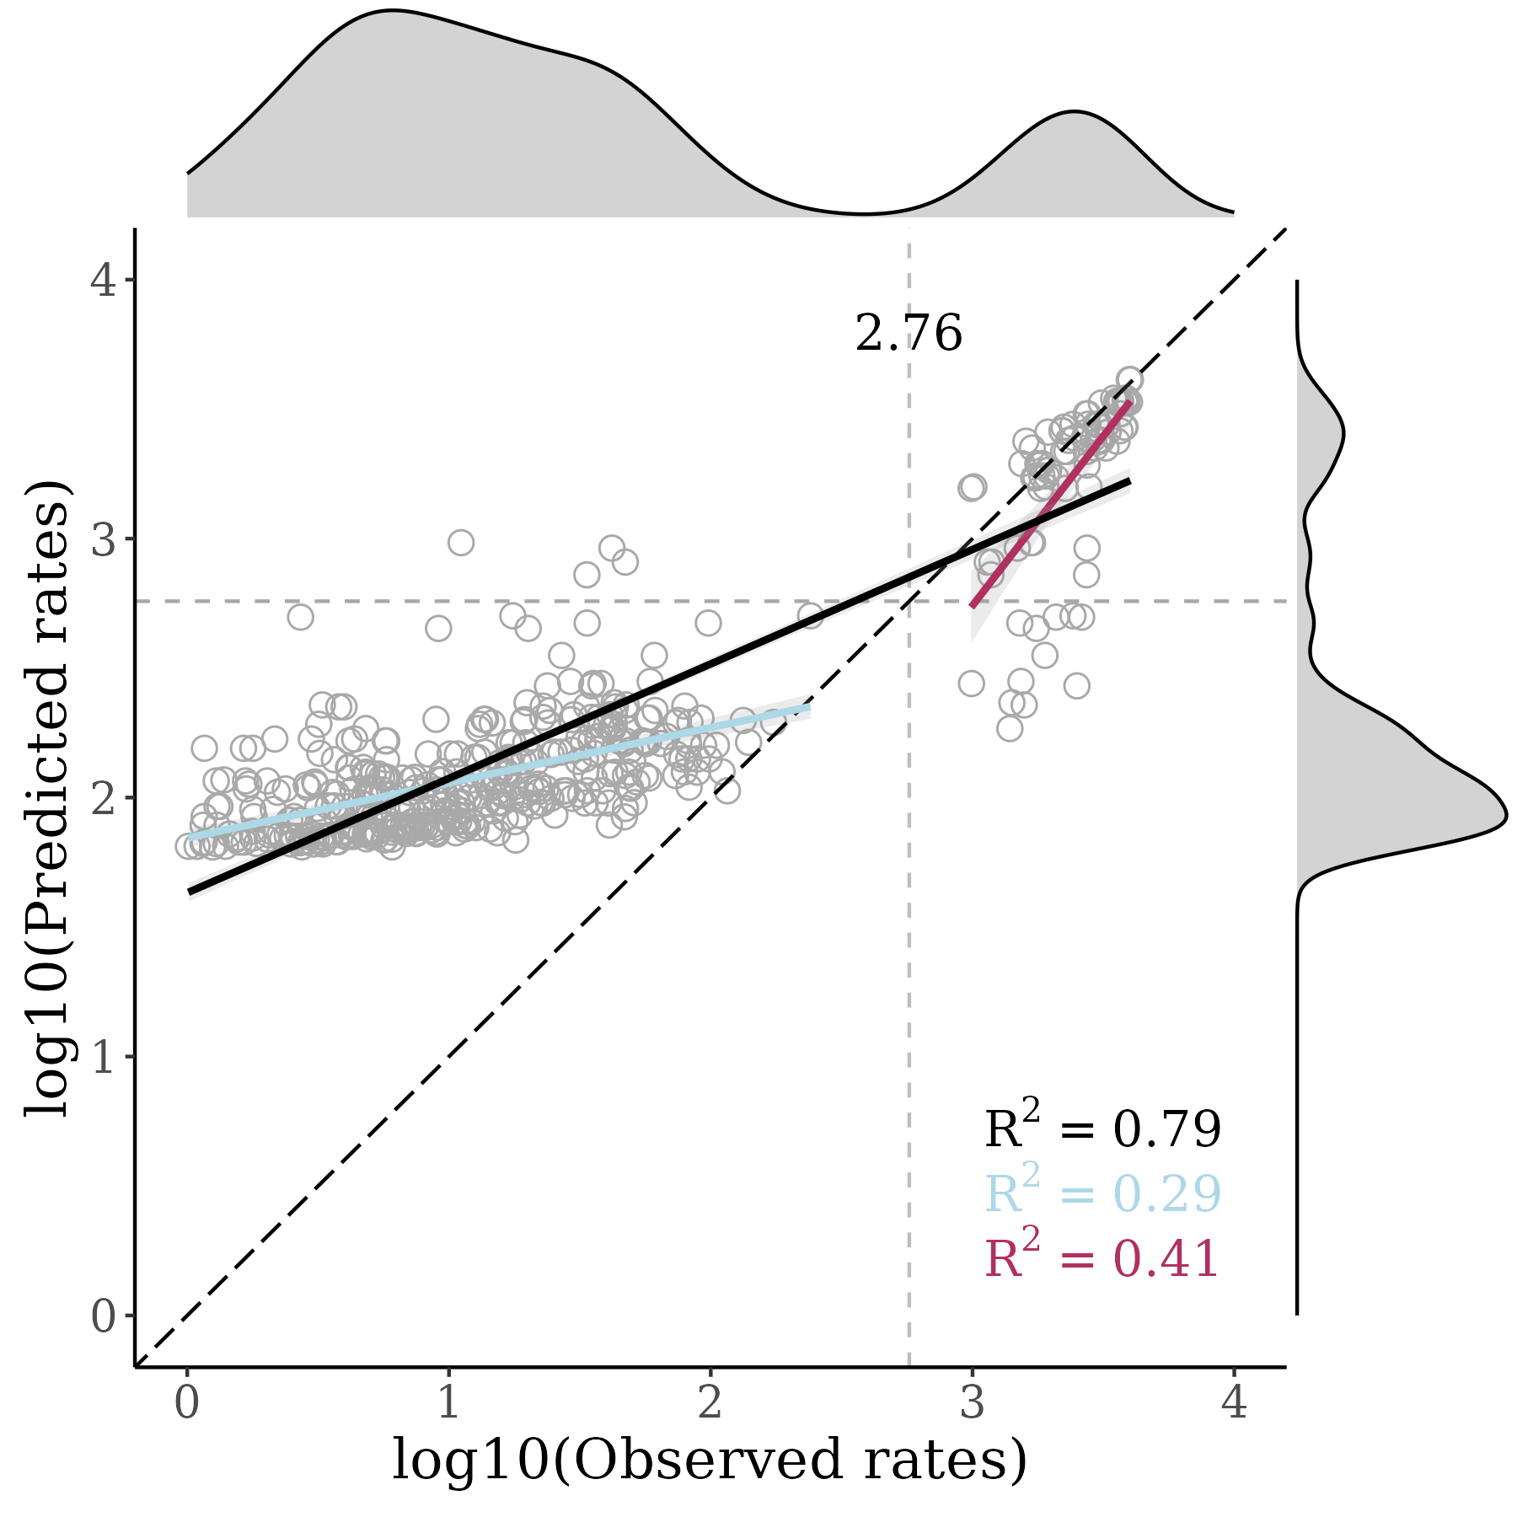

January 2023
SAMPLED SITES
MODEL PERFORMANCE
HIGH PRIORITY SITES

Slide 10

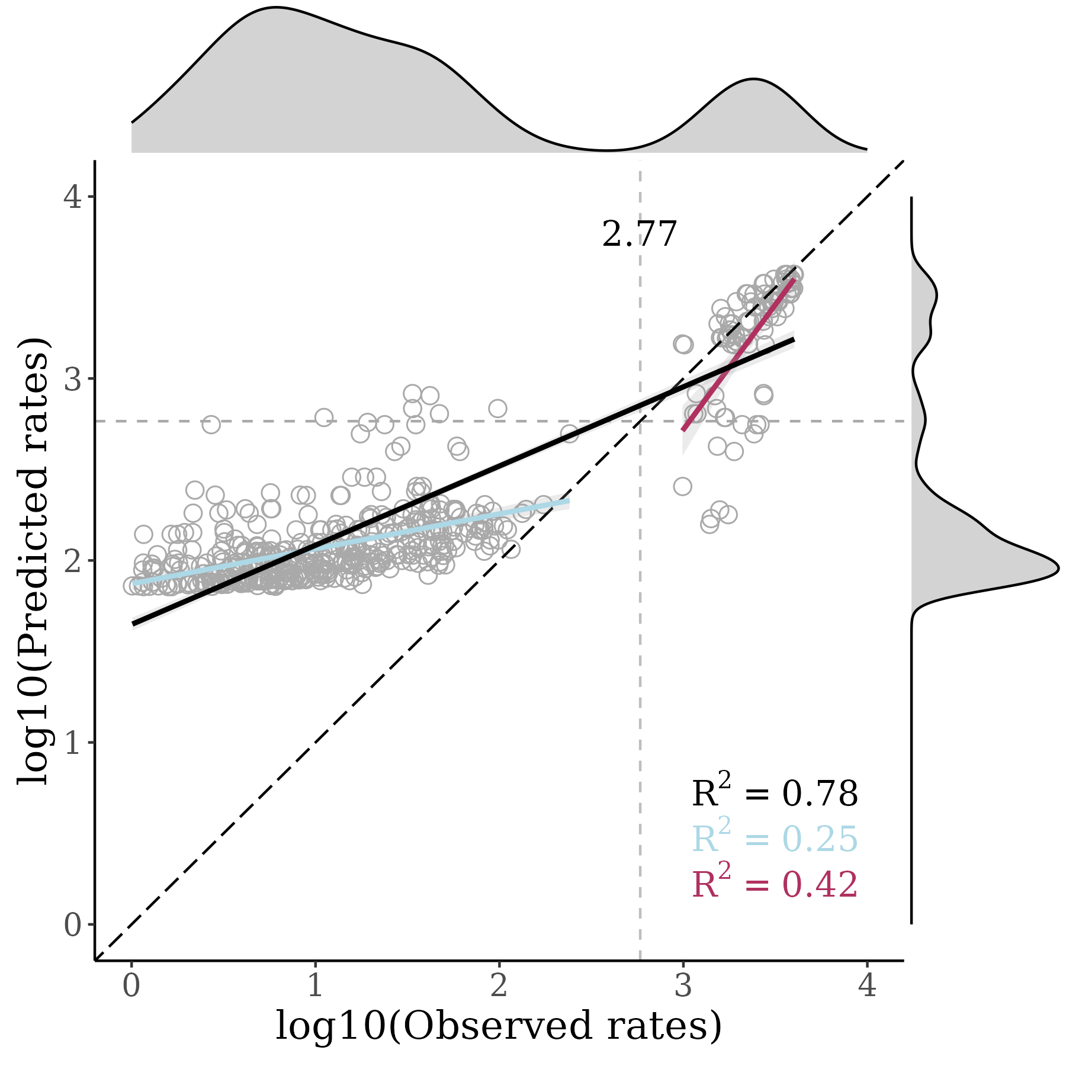

February 2023
SAMPLED SITES
MODEL PERFORMANCE
HIGH PRIORITY SITES

Slide 11

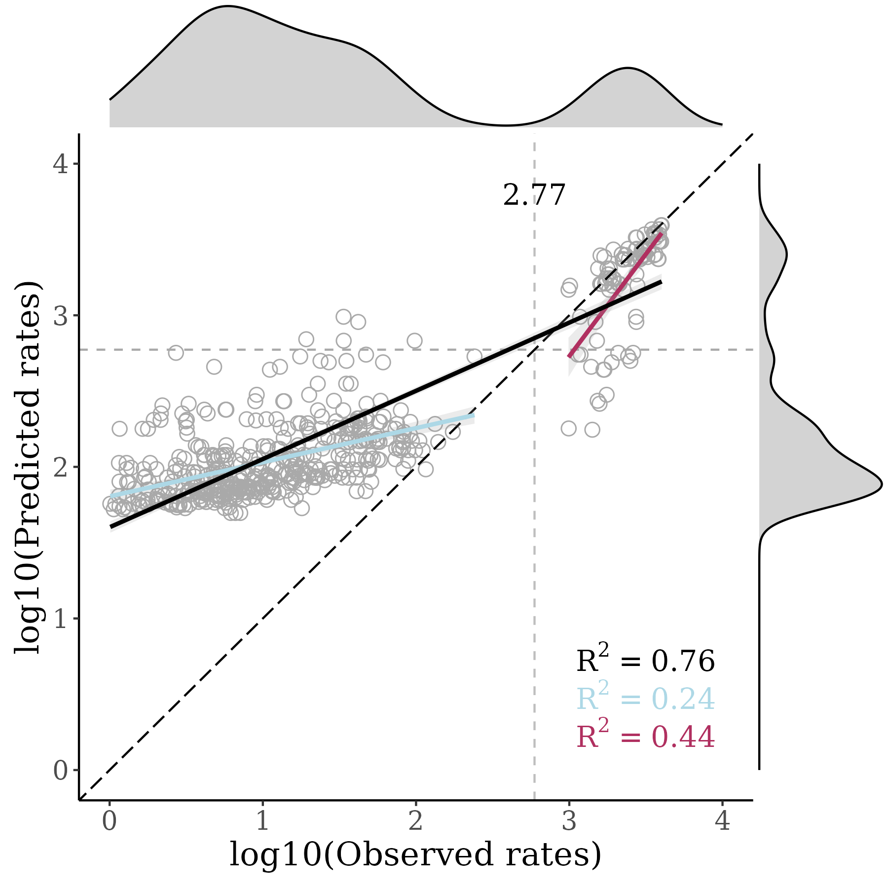
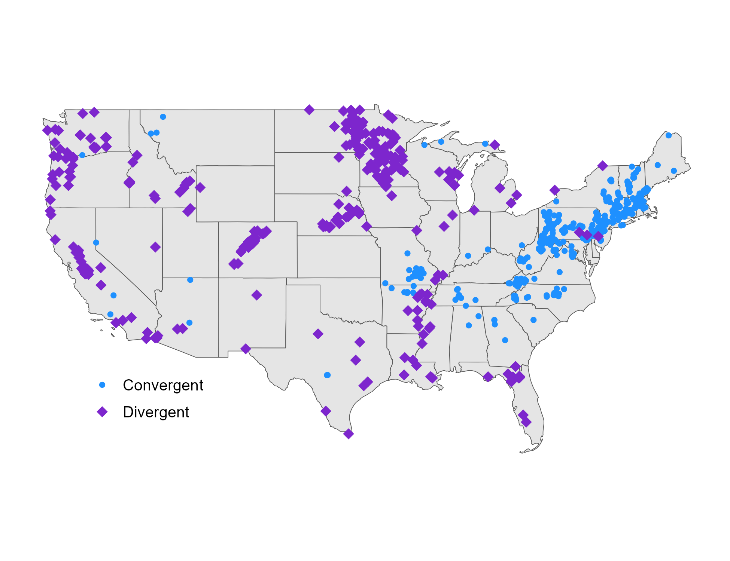
March 2023
SAMPLED SITES
MODEL PERFORMANCE
HIGH PRIORITY SITES

Slide 12

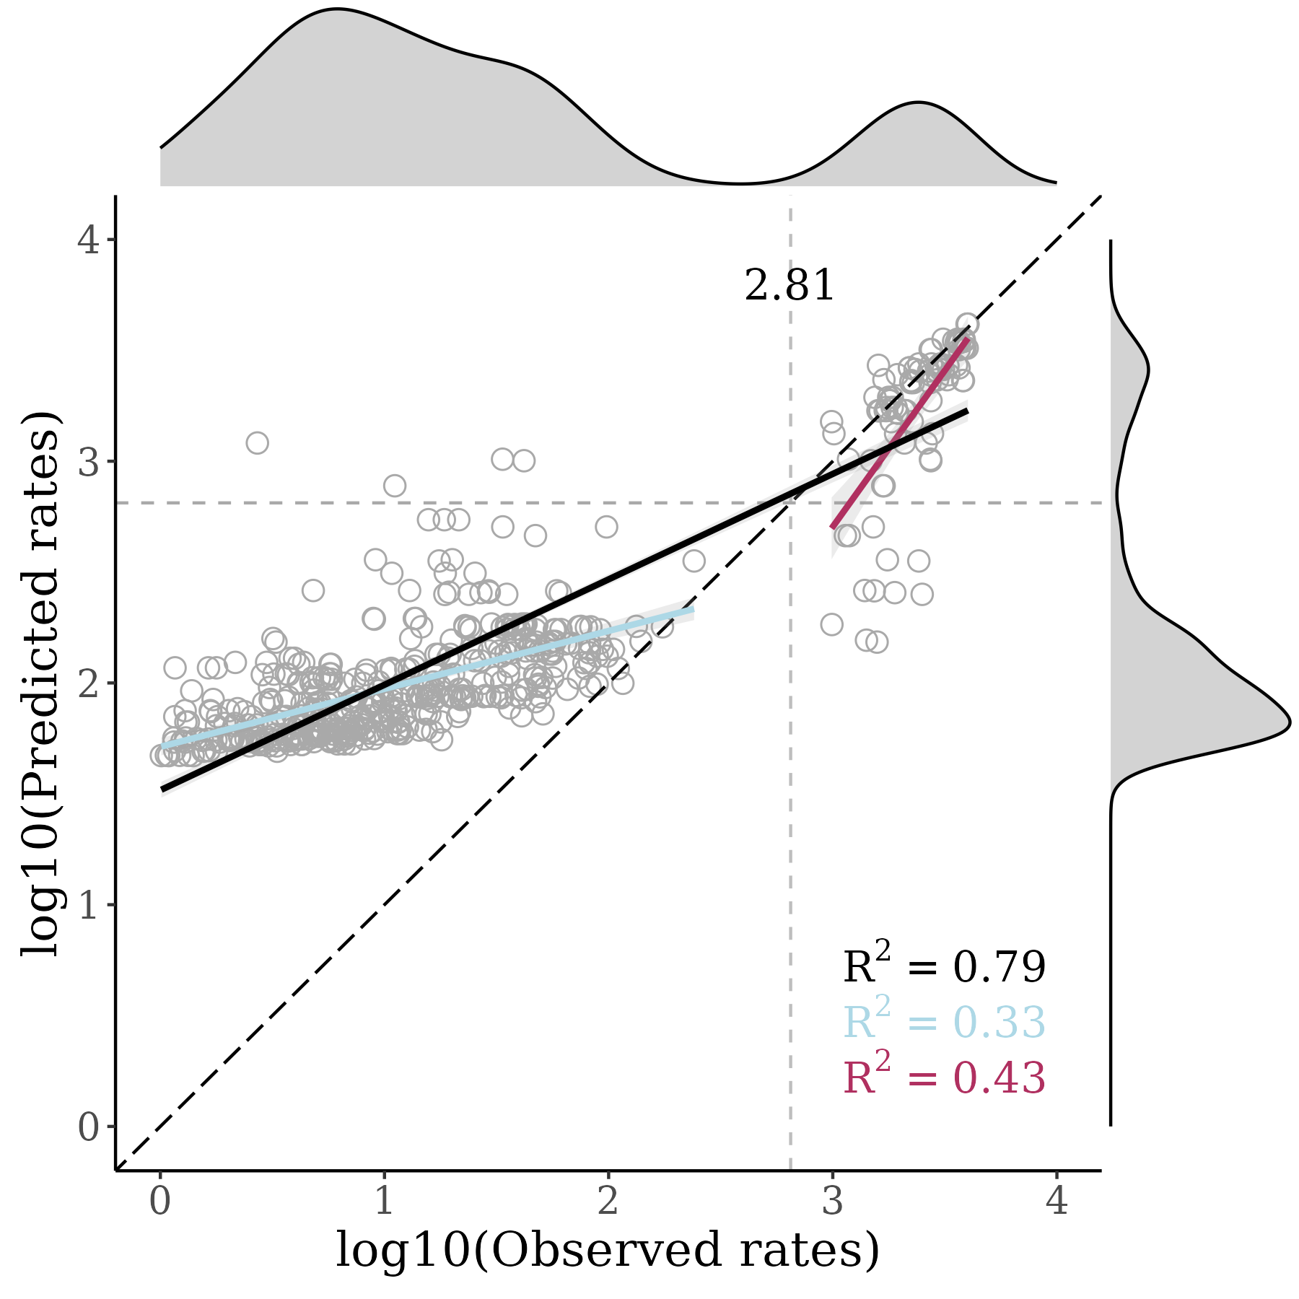

April 2023
SAMPLED SITES
MODEL PERFORMANCE
HIGH PRIORITY SITES

Slide 13

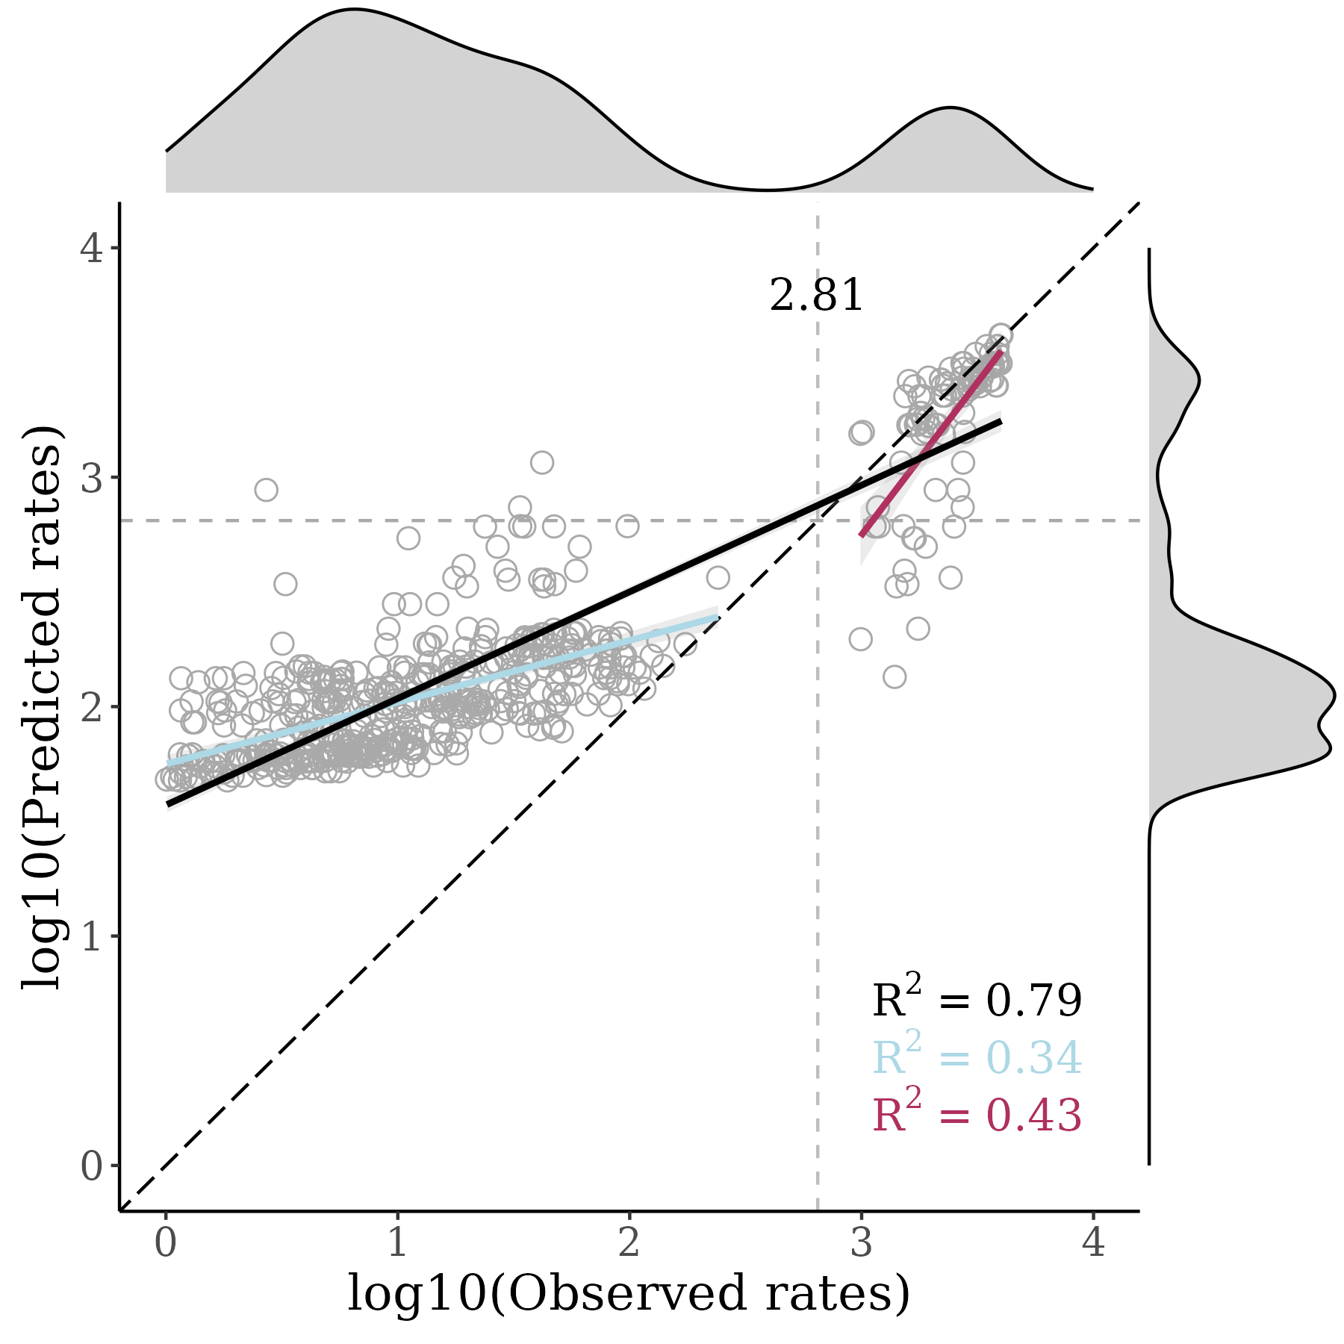

May 2023
SAMPLED SITES
MODEL PERFORMANCE
HIGH PRIORITY SITES

Slide 14

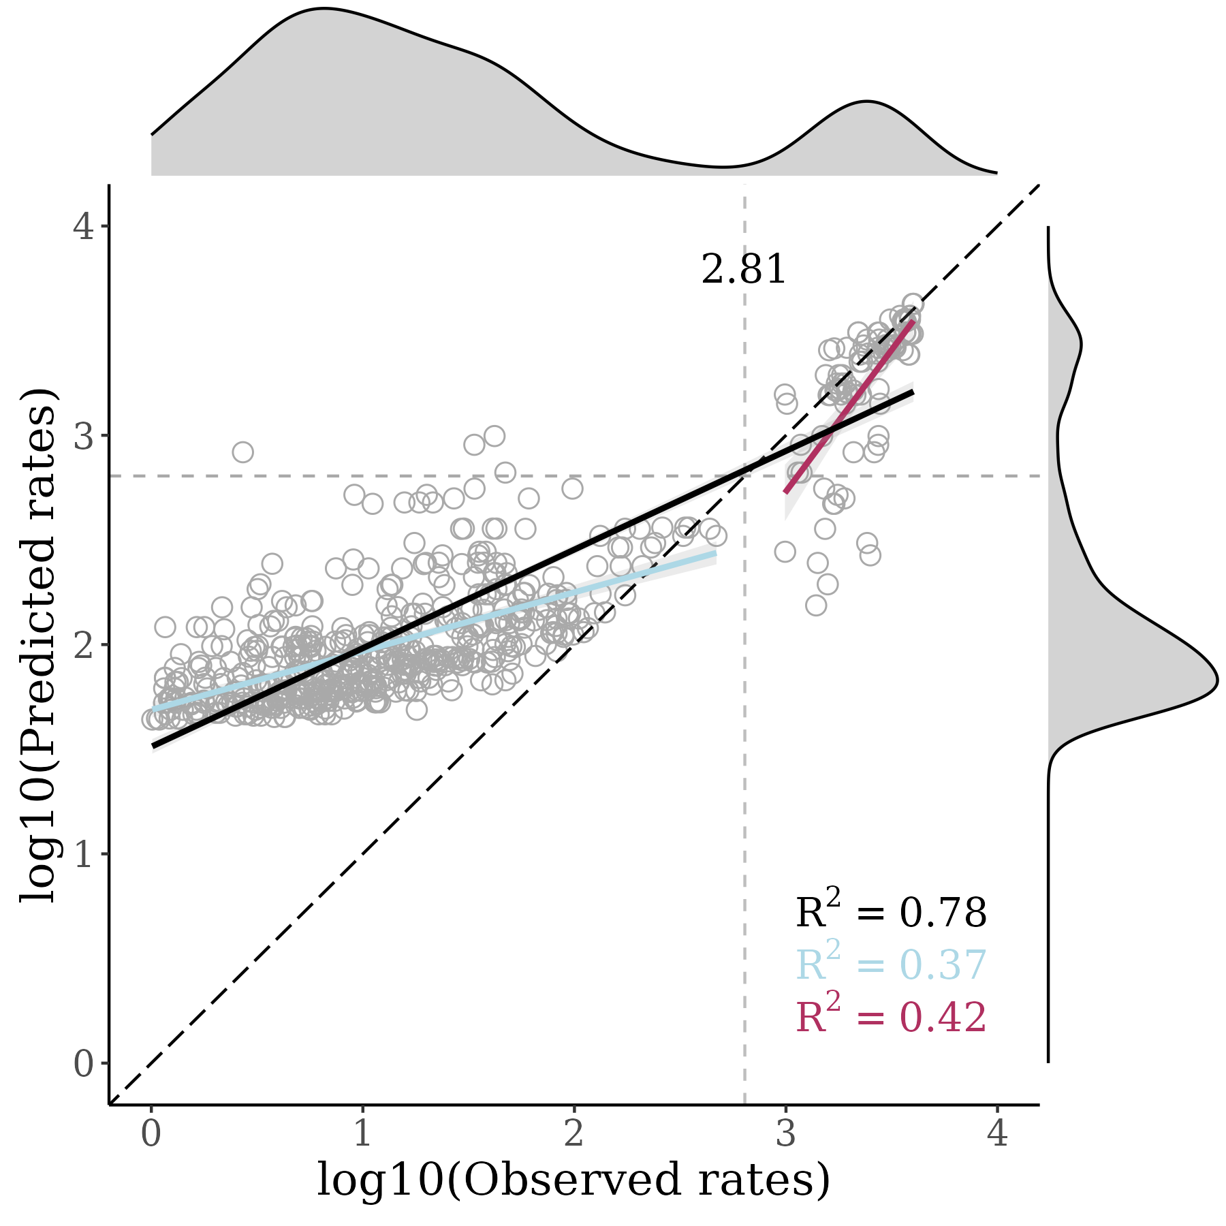
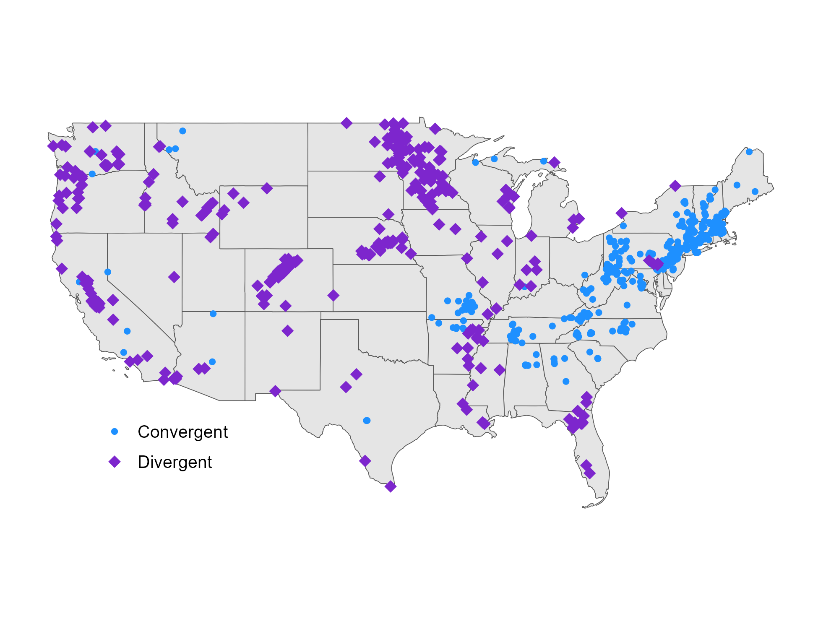
June 2023
SAMPLED SITES
MODEL PERFORMANCE
HIGH PRIORITY SITES

Slide 15

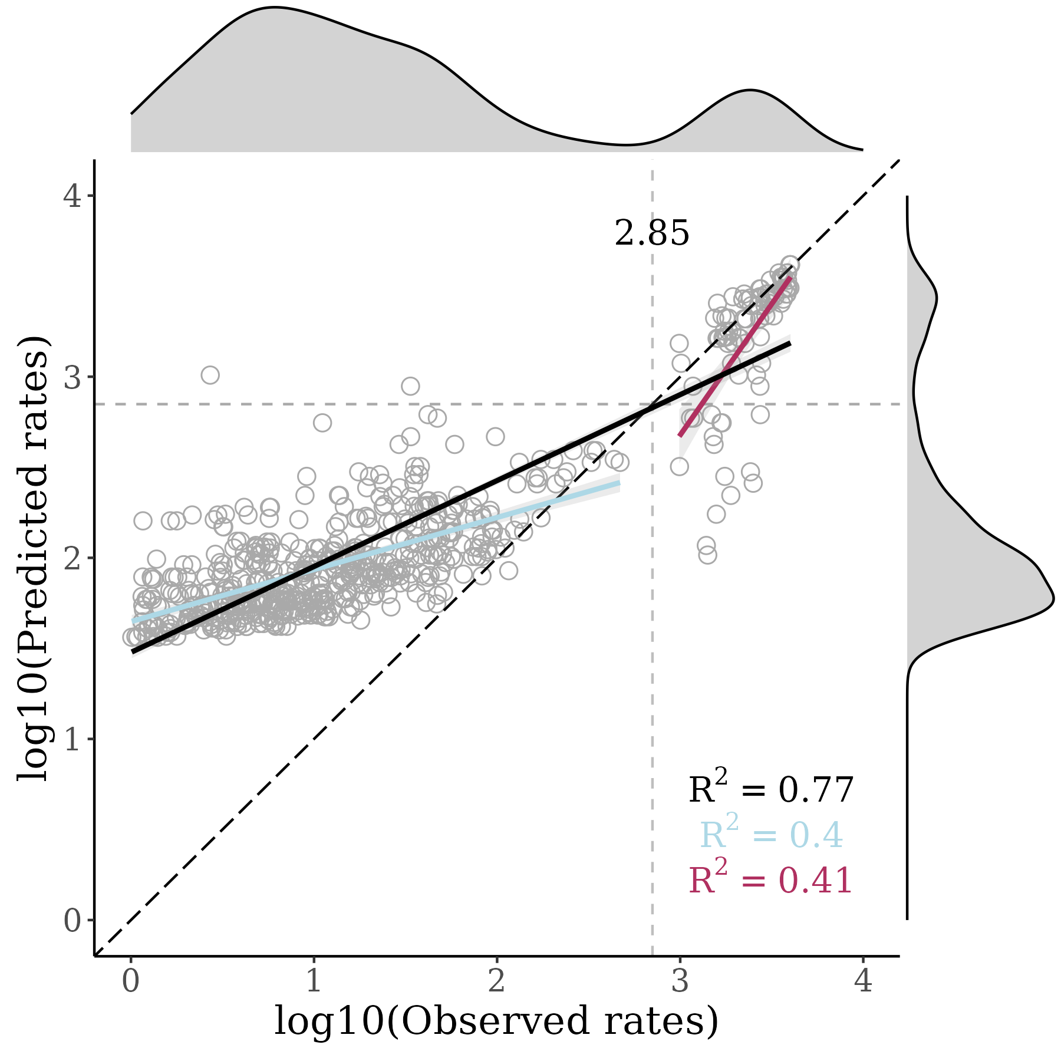
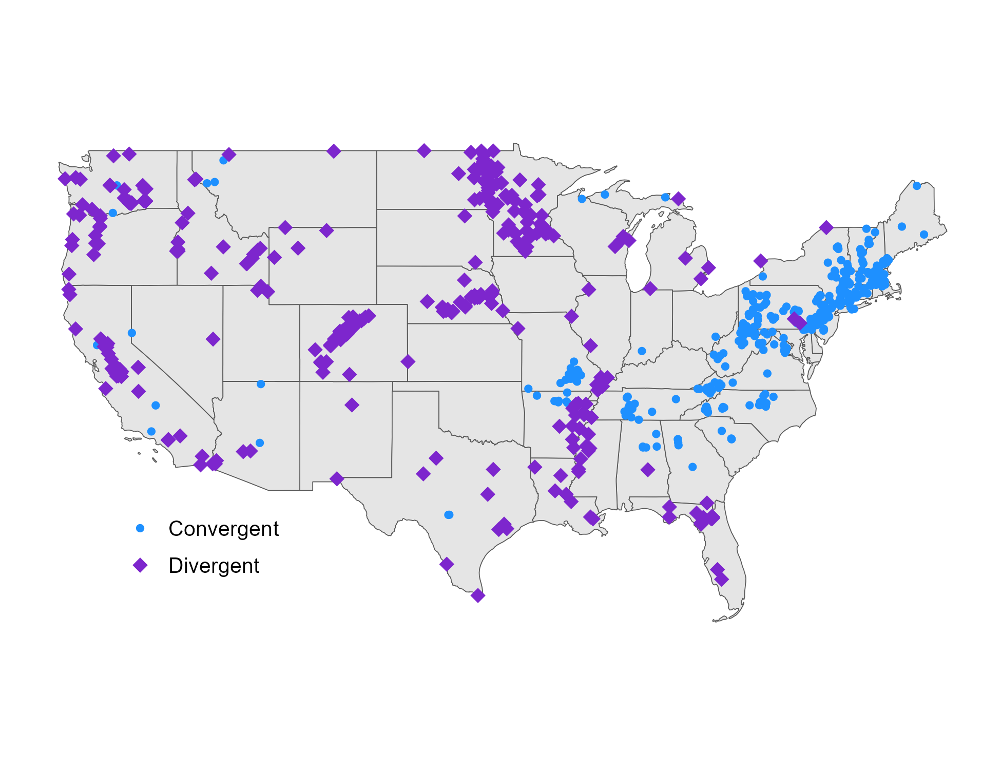
July 2023
SAMPLED SITES
MODEL PERFORMANCE
HIGH PRIORITY SITES

Slide 16

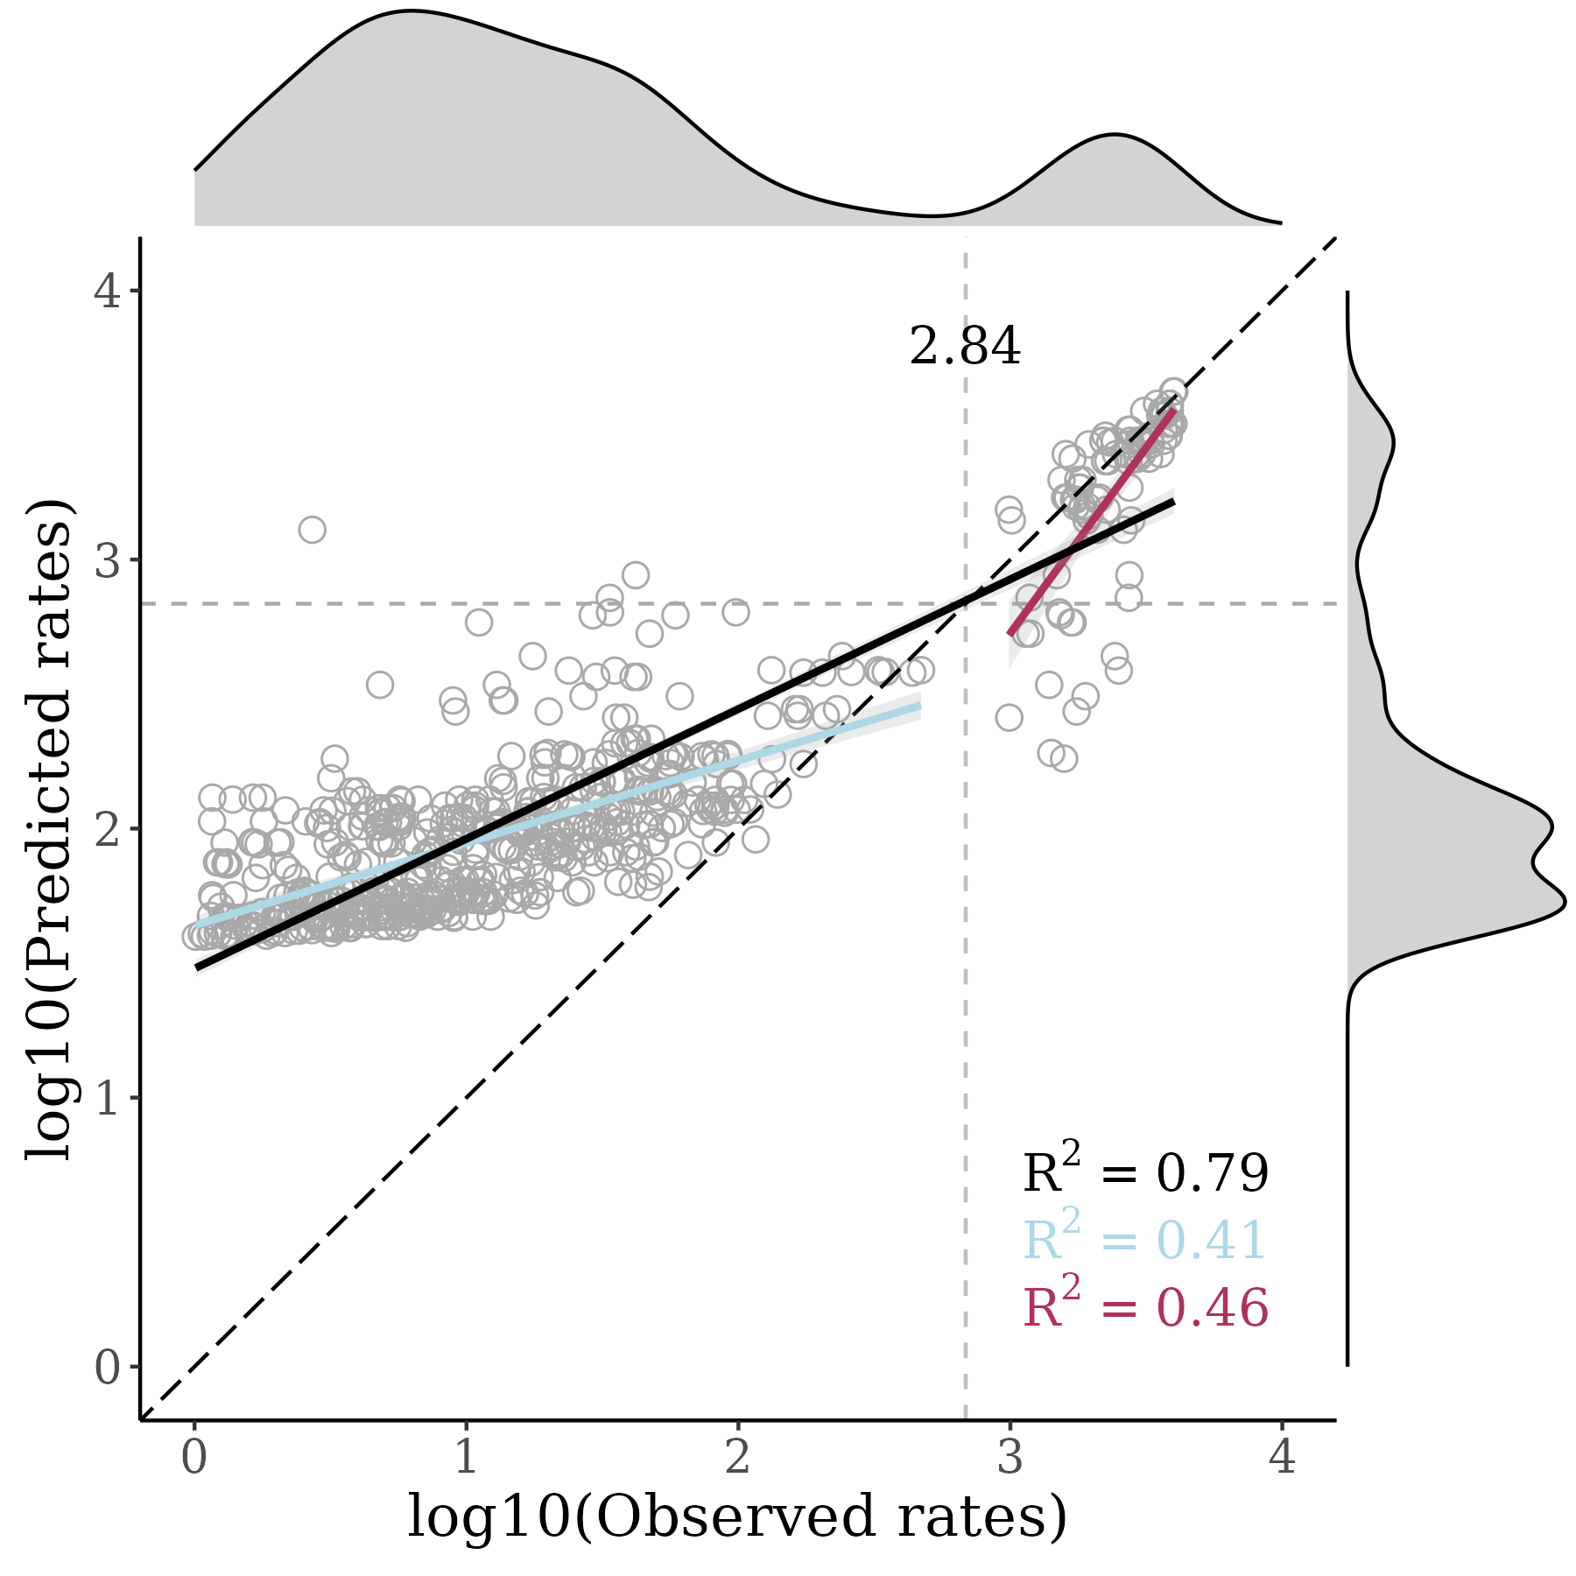

August 2023
SAMPLED SITES
MODEL PERFORMANCE
HIGH PRIORITY SITES

Slide 17

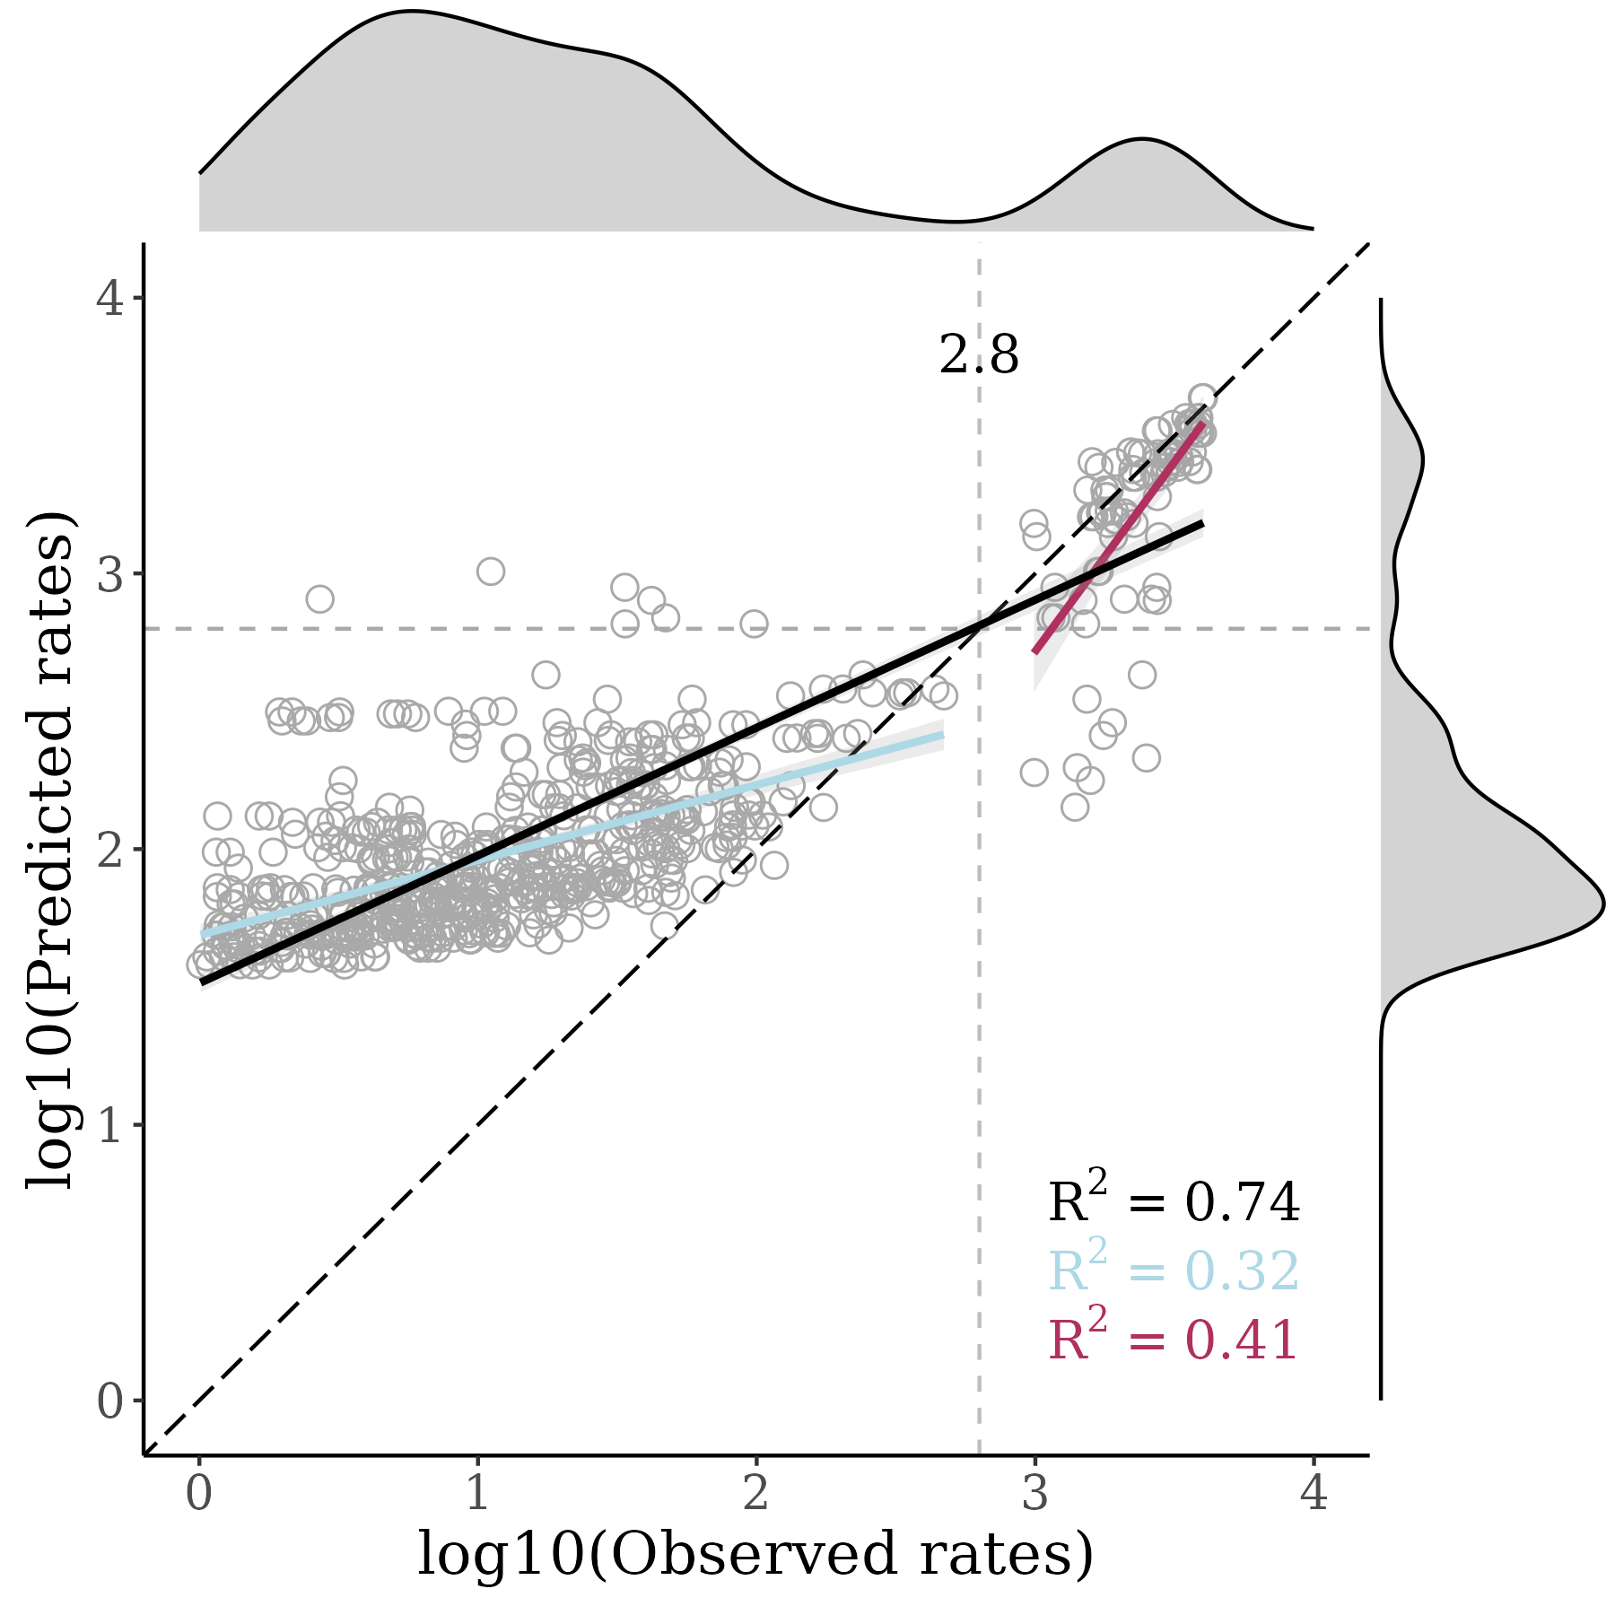
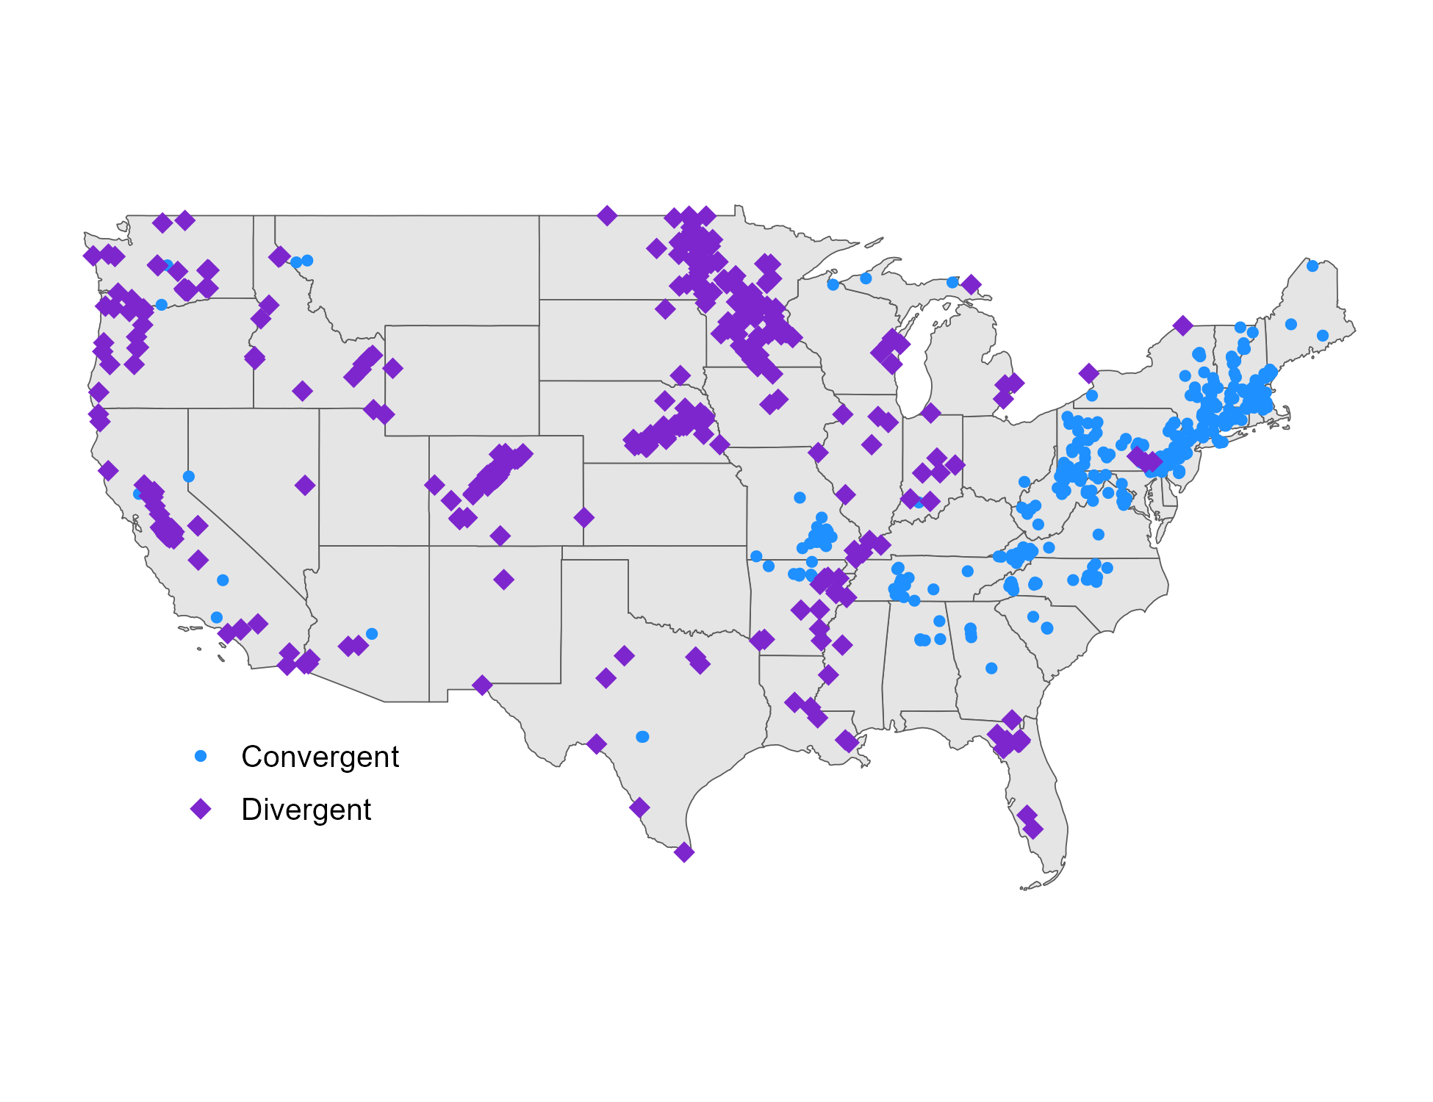
September 2023
SAMPLED SITES
MODEL PERFORMANCE
HIGH PRIORITY SITES

Slide 18

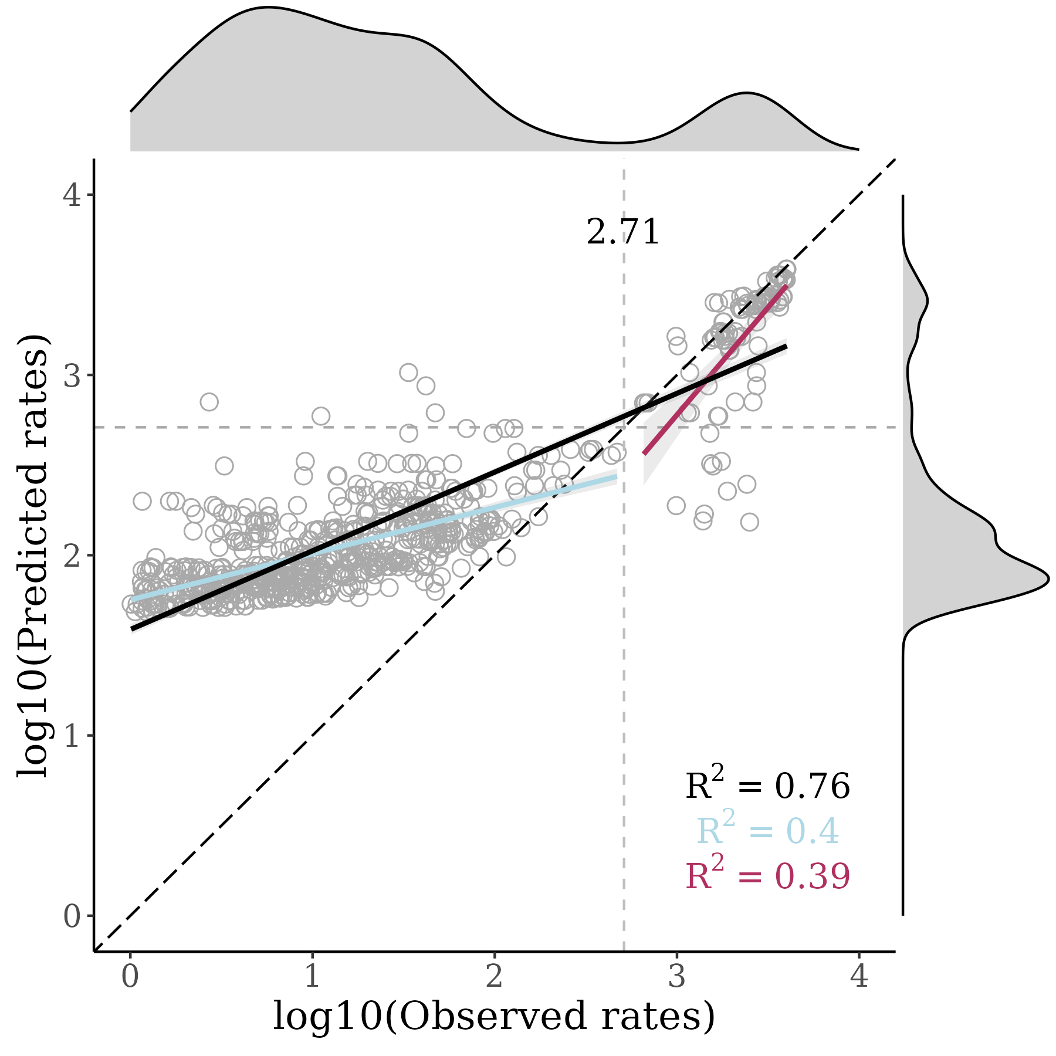

October 2023
SAMPLED SITES
MODEL PERFORMANCE
HIGH PRIORITY SITES

Slide 19

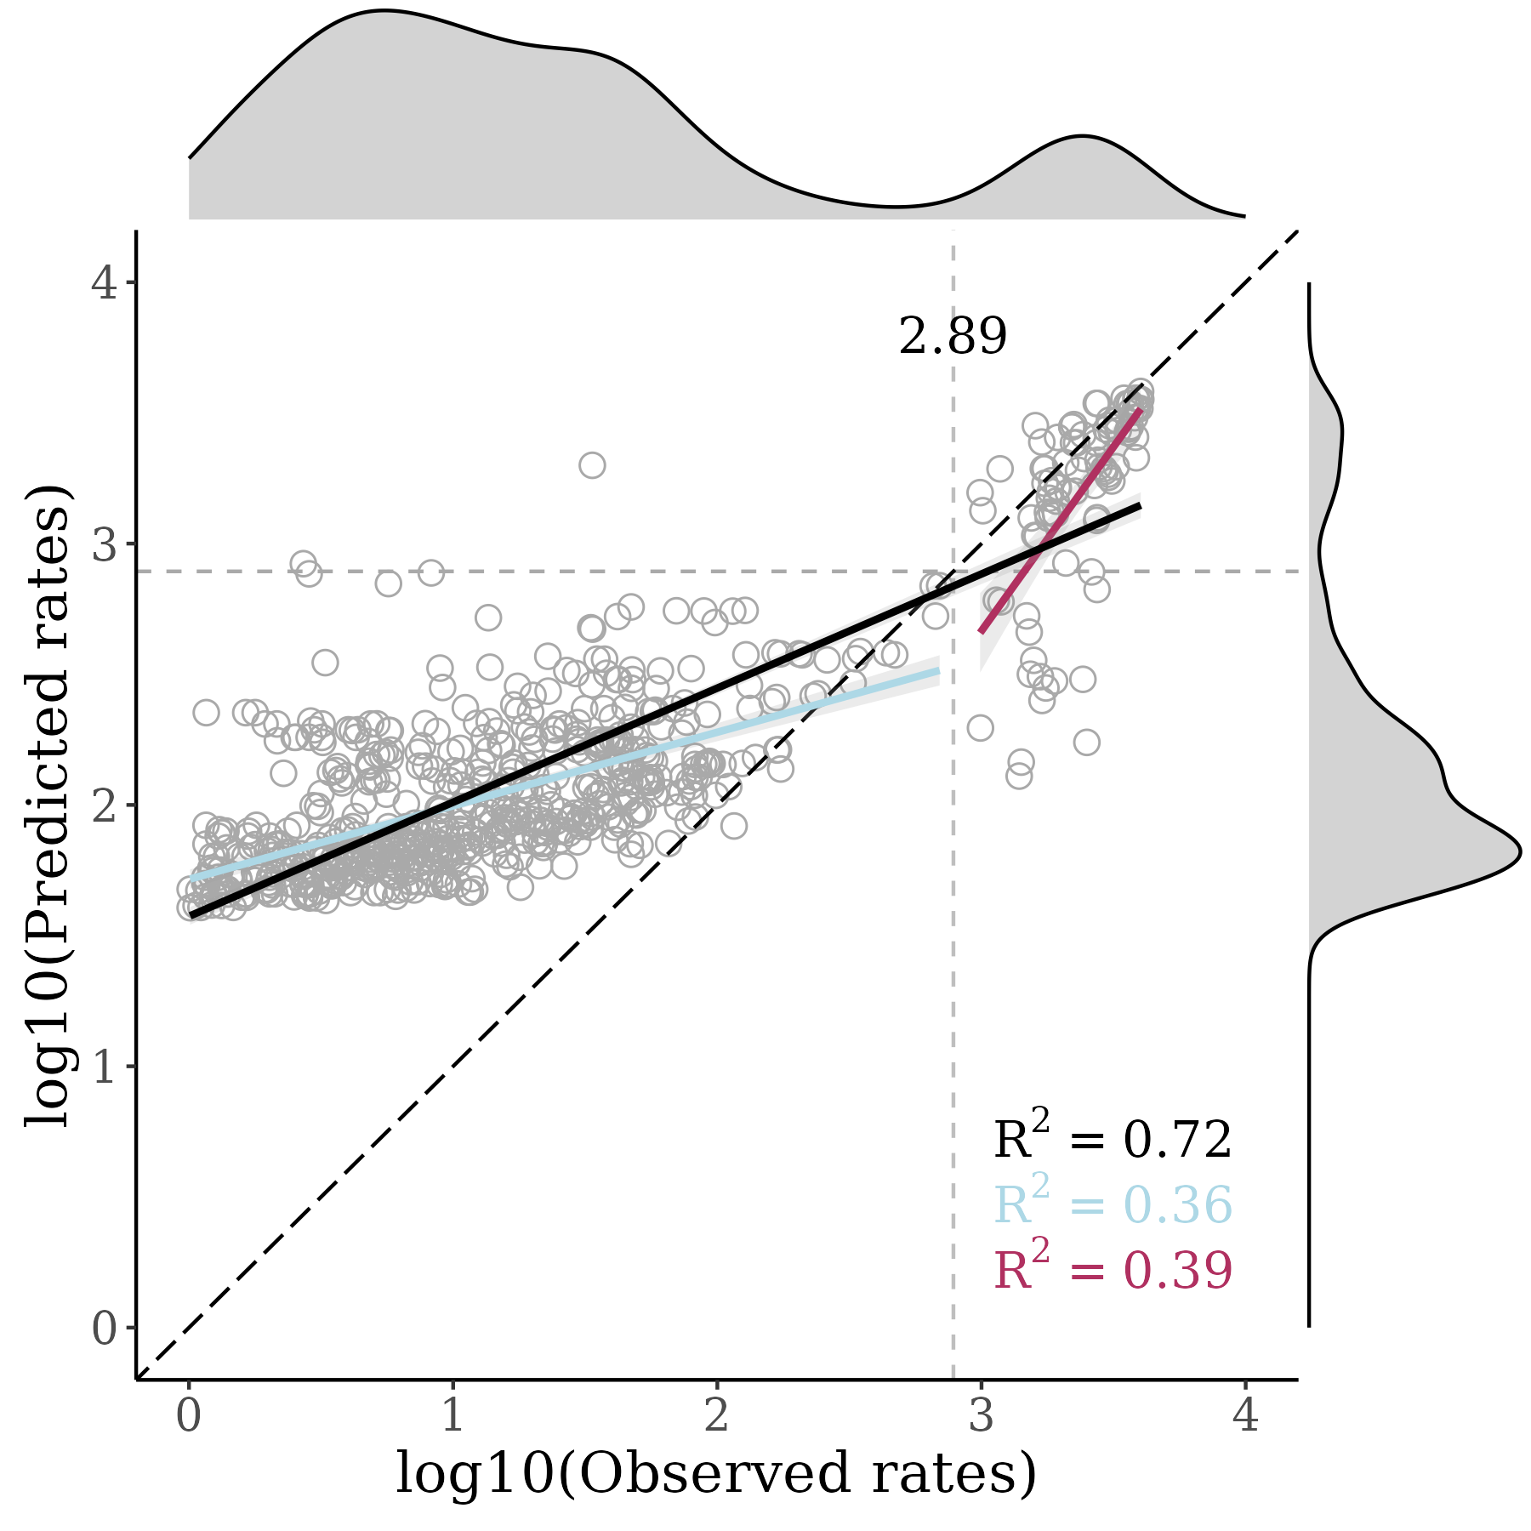
November 2023
SAMPLED SITES
MODEL PERFORMANCE
HIGH PRIORITY SITES

